Slide 1
Lecture 36: Review

Slide 2
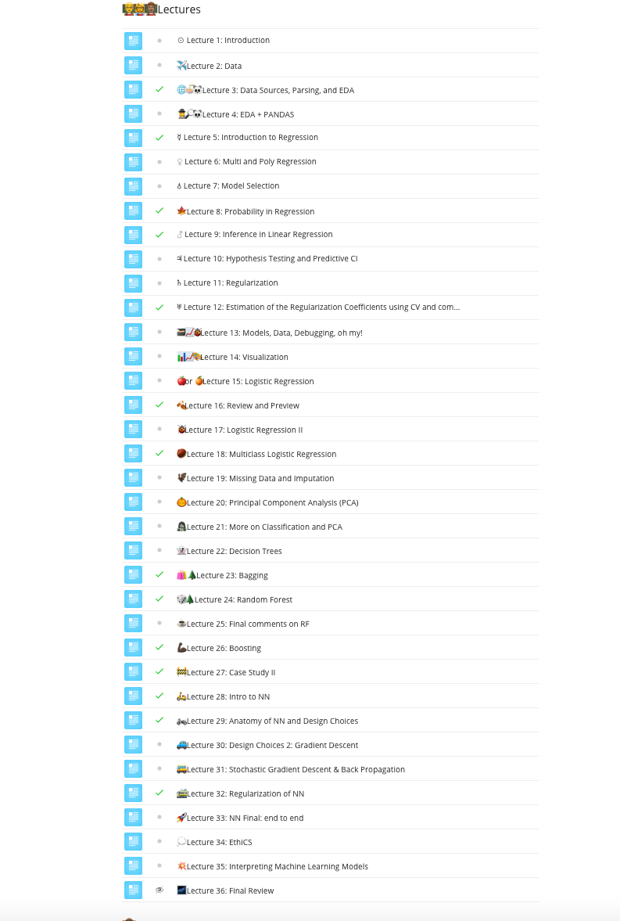

Slide 3
Uncertainty in model and prediction
Cross validation
Overfitting: Variance & Bias
Pandas
NumPy
Scikit-Learn
PCA & dimensionality reduction
Statistical Learning
Computing Tools
Matplotlib
Methods of regularization:
Lasso and Ridge
Regression
Classification
Logistic
Linear
Trees
KNN
Neural Networks

Slide 4
Uncertainty in model and prediction
Cross validation
Overfitting: Variance & Bias
Pandas
NumPy
Scikit-Learn
PCA & dimensionality reduction
Statistical Learning
Computing Tools
Matplotlib
Methods of regularization:
Lasso and Ridge
Regression
Classification
Logistic
Linear
Trees
KNN
Neural Networks

Slide 5
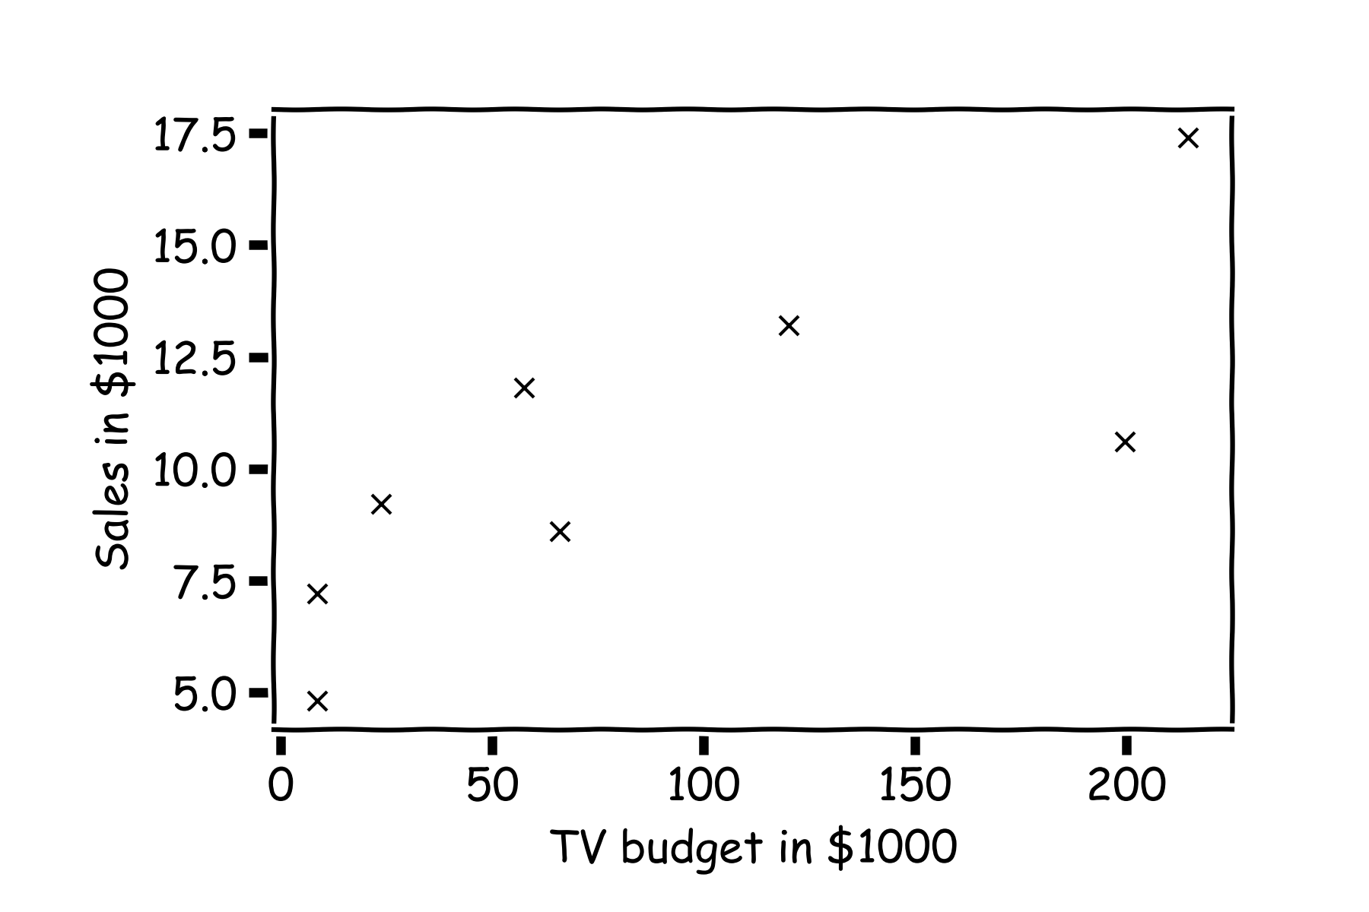
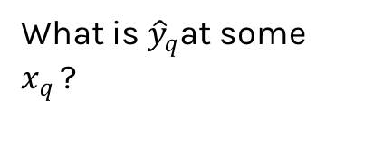
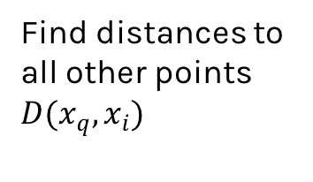
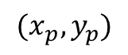
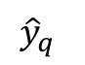
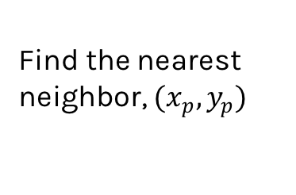
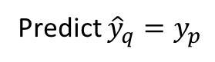
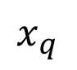
Simple Prediction Model (KNN)
Notes:
Is it clear that x_q is really x_i,q? (DLS)

Slide 6
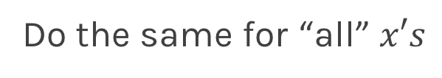
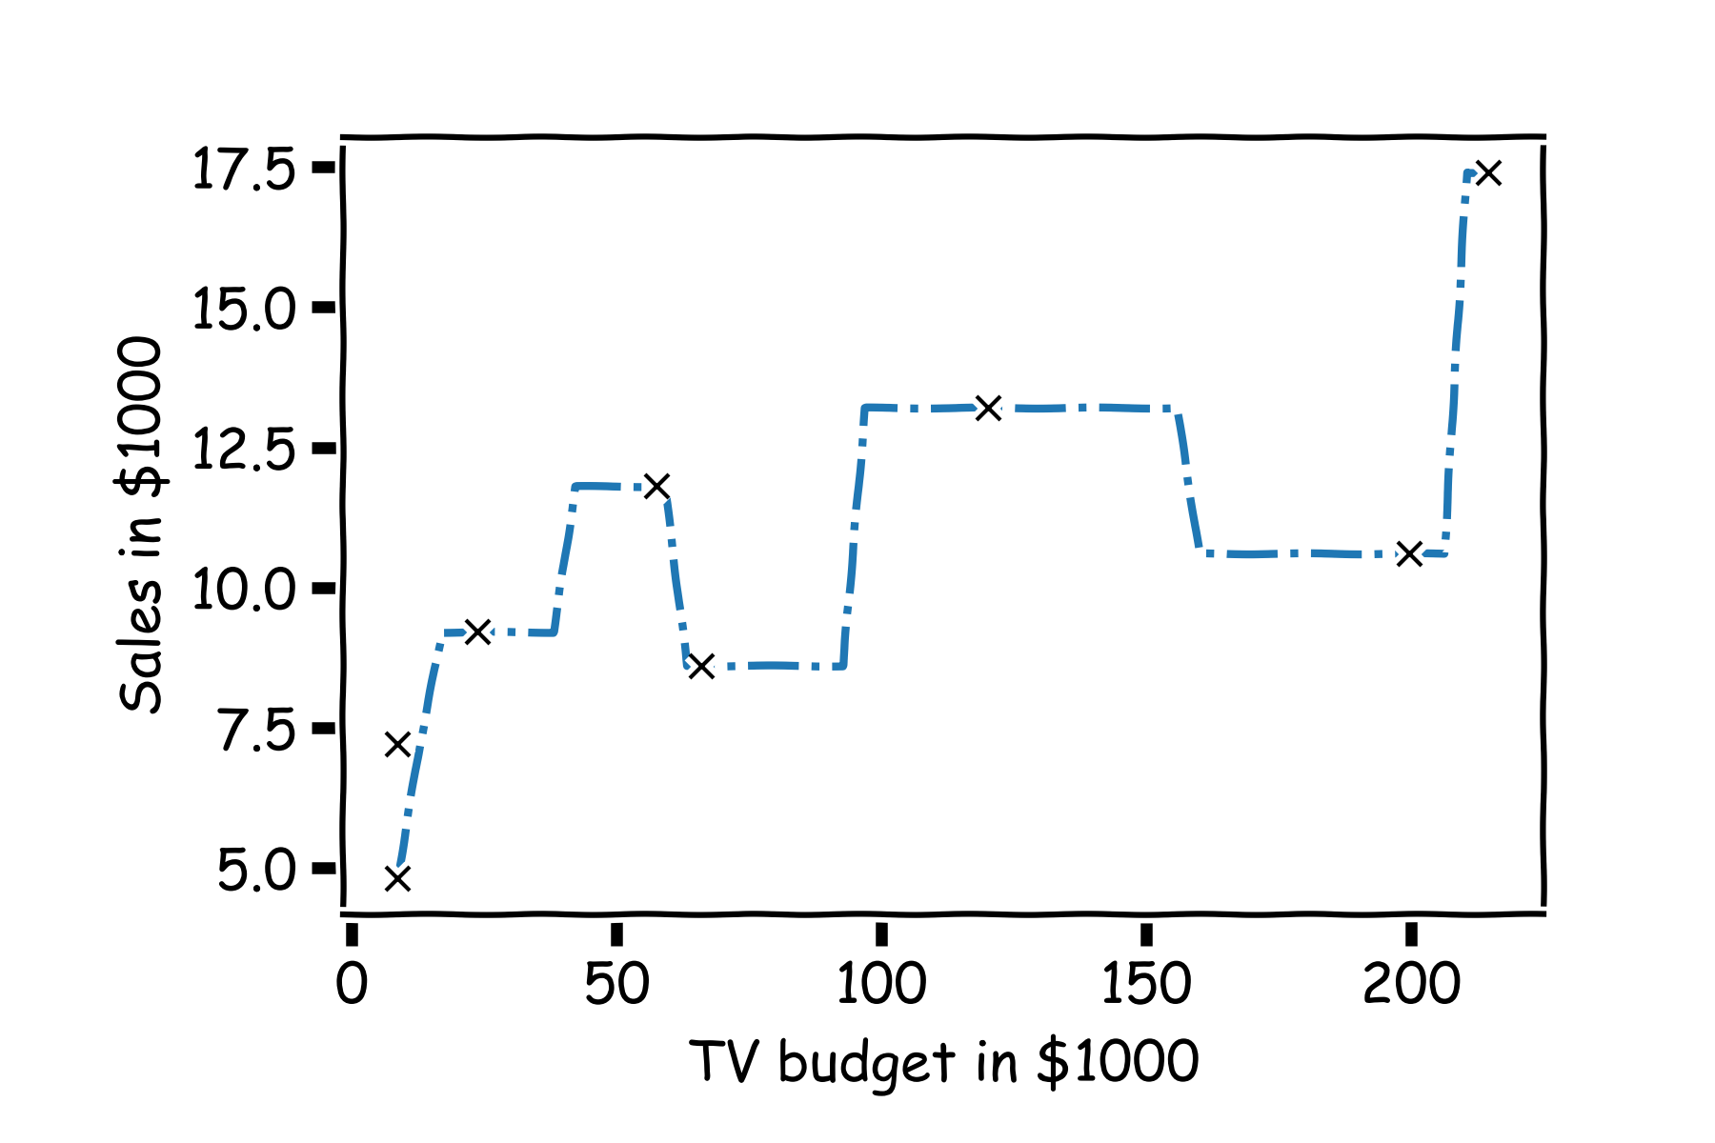
Simple Prediction Model

Slide 7
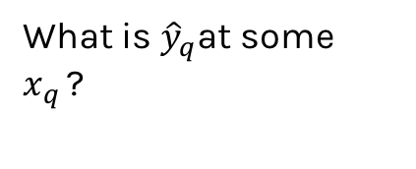
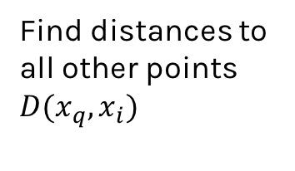
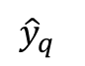
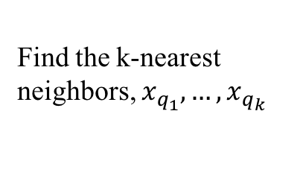
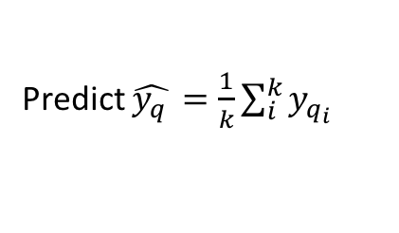
Extend the Prediction Model
Notes:
Change indeces and show k-nearest

Slide 8
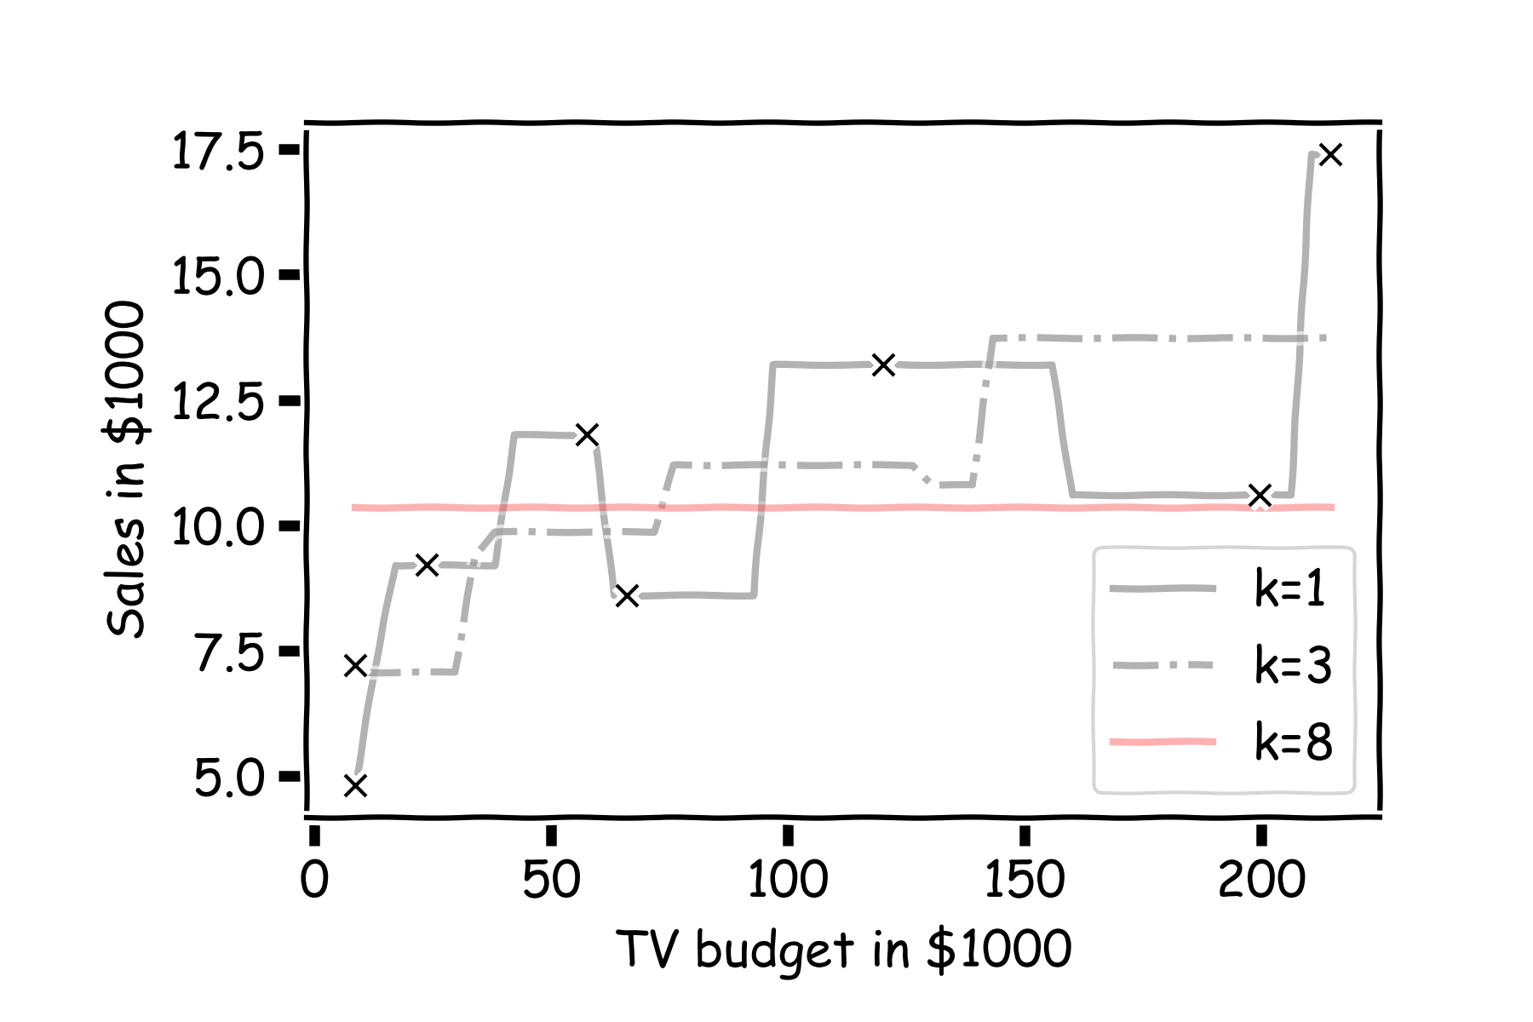
Simple Prediction Models
Notes:
Change indeces and show k-nearest

Slide 9

Simple Prediction Models
We can try different k-models on more data
Notes:
Change indeces and show k-nearest

Slide 10
Uncertainty in model and prediction
Cross validation
Overfitting: Variance & Bias
Pandas
NumPy
Scikit-Learn
PCA & dimensionality reduction
Statistical Learning
Computing Tools
Matplotlib
Methods of regularization:
Lasso and Ridge
Regression
Classification
Logistic
Linear
Trees
KNN
Neural Networks

Slide 11
Uncertainty in model and prediction
Cross validation
Overfitting: Variance & Bias
Pandas
NumPy
Scikit-Learn
PCA & dimensionality reduction
Statistical Learning
Computing Tools
Matplotlib
Methods of regularization:
Lasso and Ridge
Regression
Classification
Logistic
Linear
Trees
KNN
Neural Networks

Slide 12
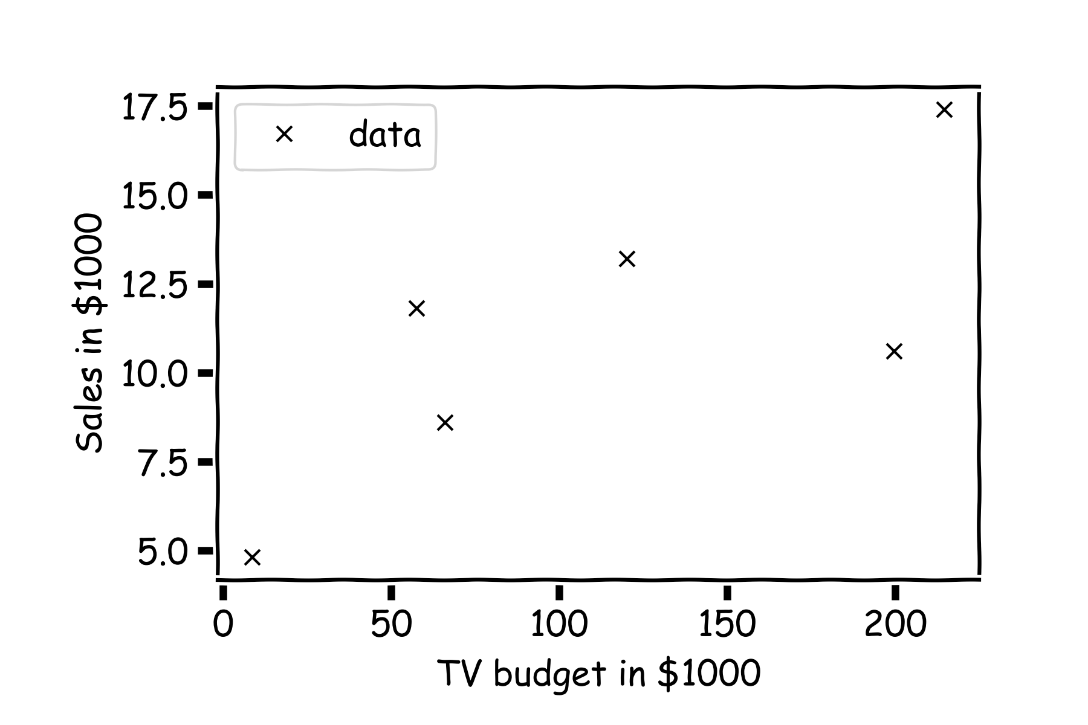
Estimate of the regression coefficients
For a given data set

Slide 13
Estimate of the regression coefficients (cont)
Is this line good?

Slide 14
Estimate of the regression coefficients (cont)
Maybe this one?

Slide 15
Estimate of the regression coefficients (cont)
Or this one?

Slide 16
Estimate of the regression coefficients (cont)
Question: Which line is the best?
First calculate the residuals

Slide 17
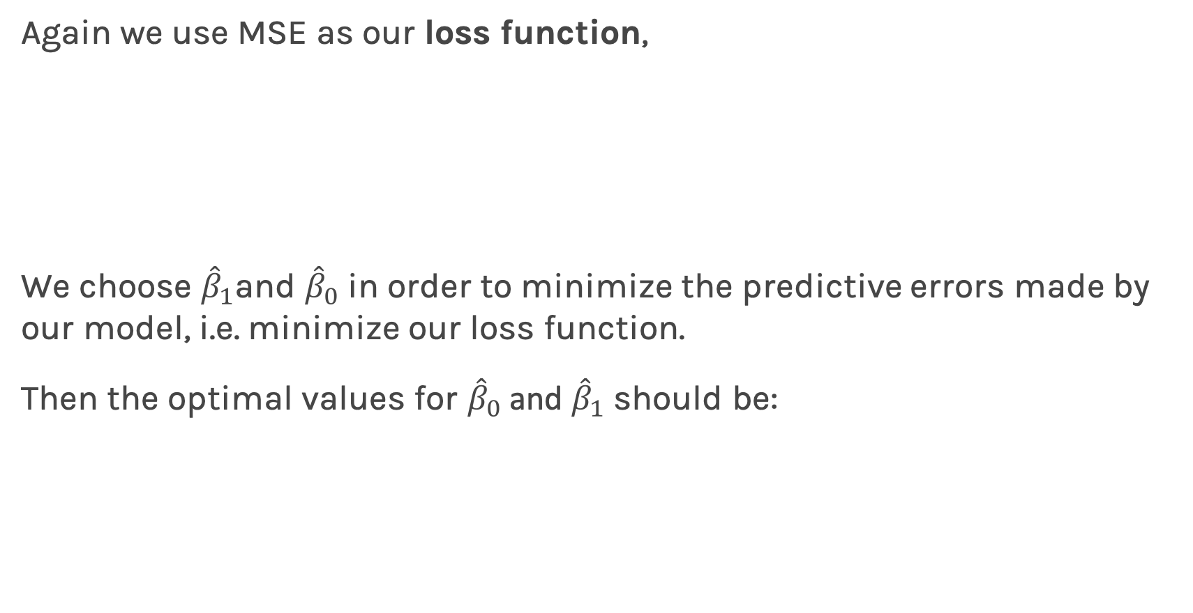
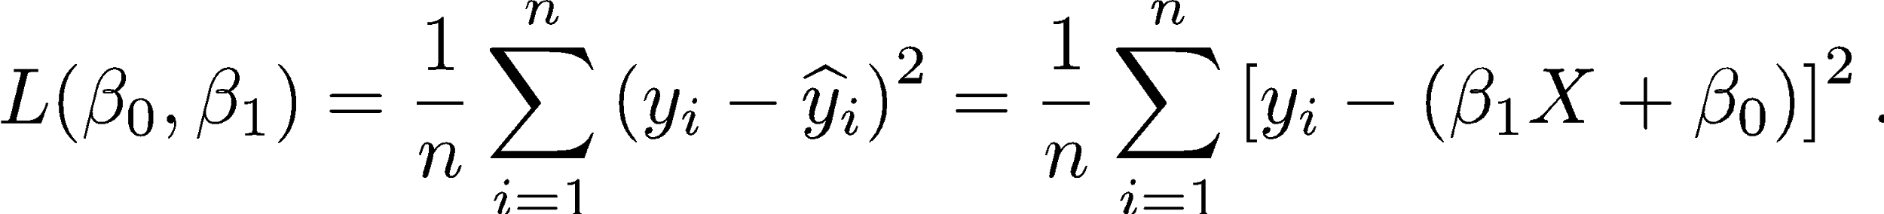
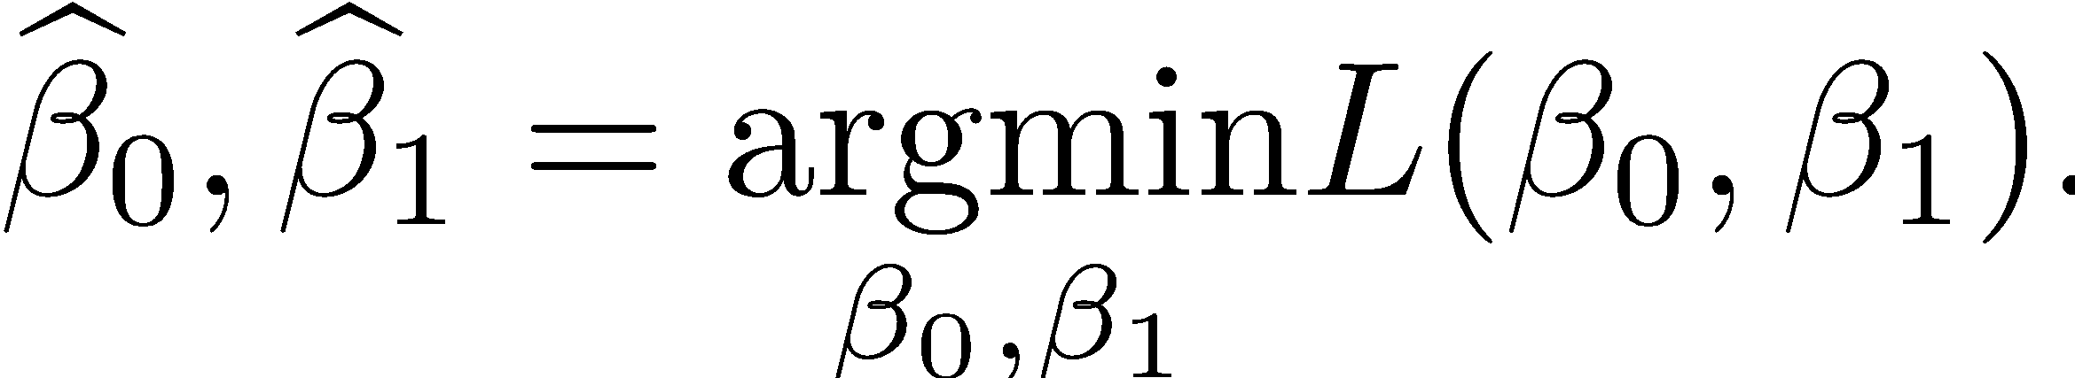
Estimate of the regression coefficients (cont)

Slide 18
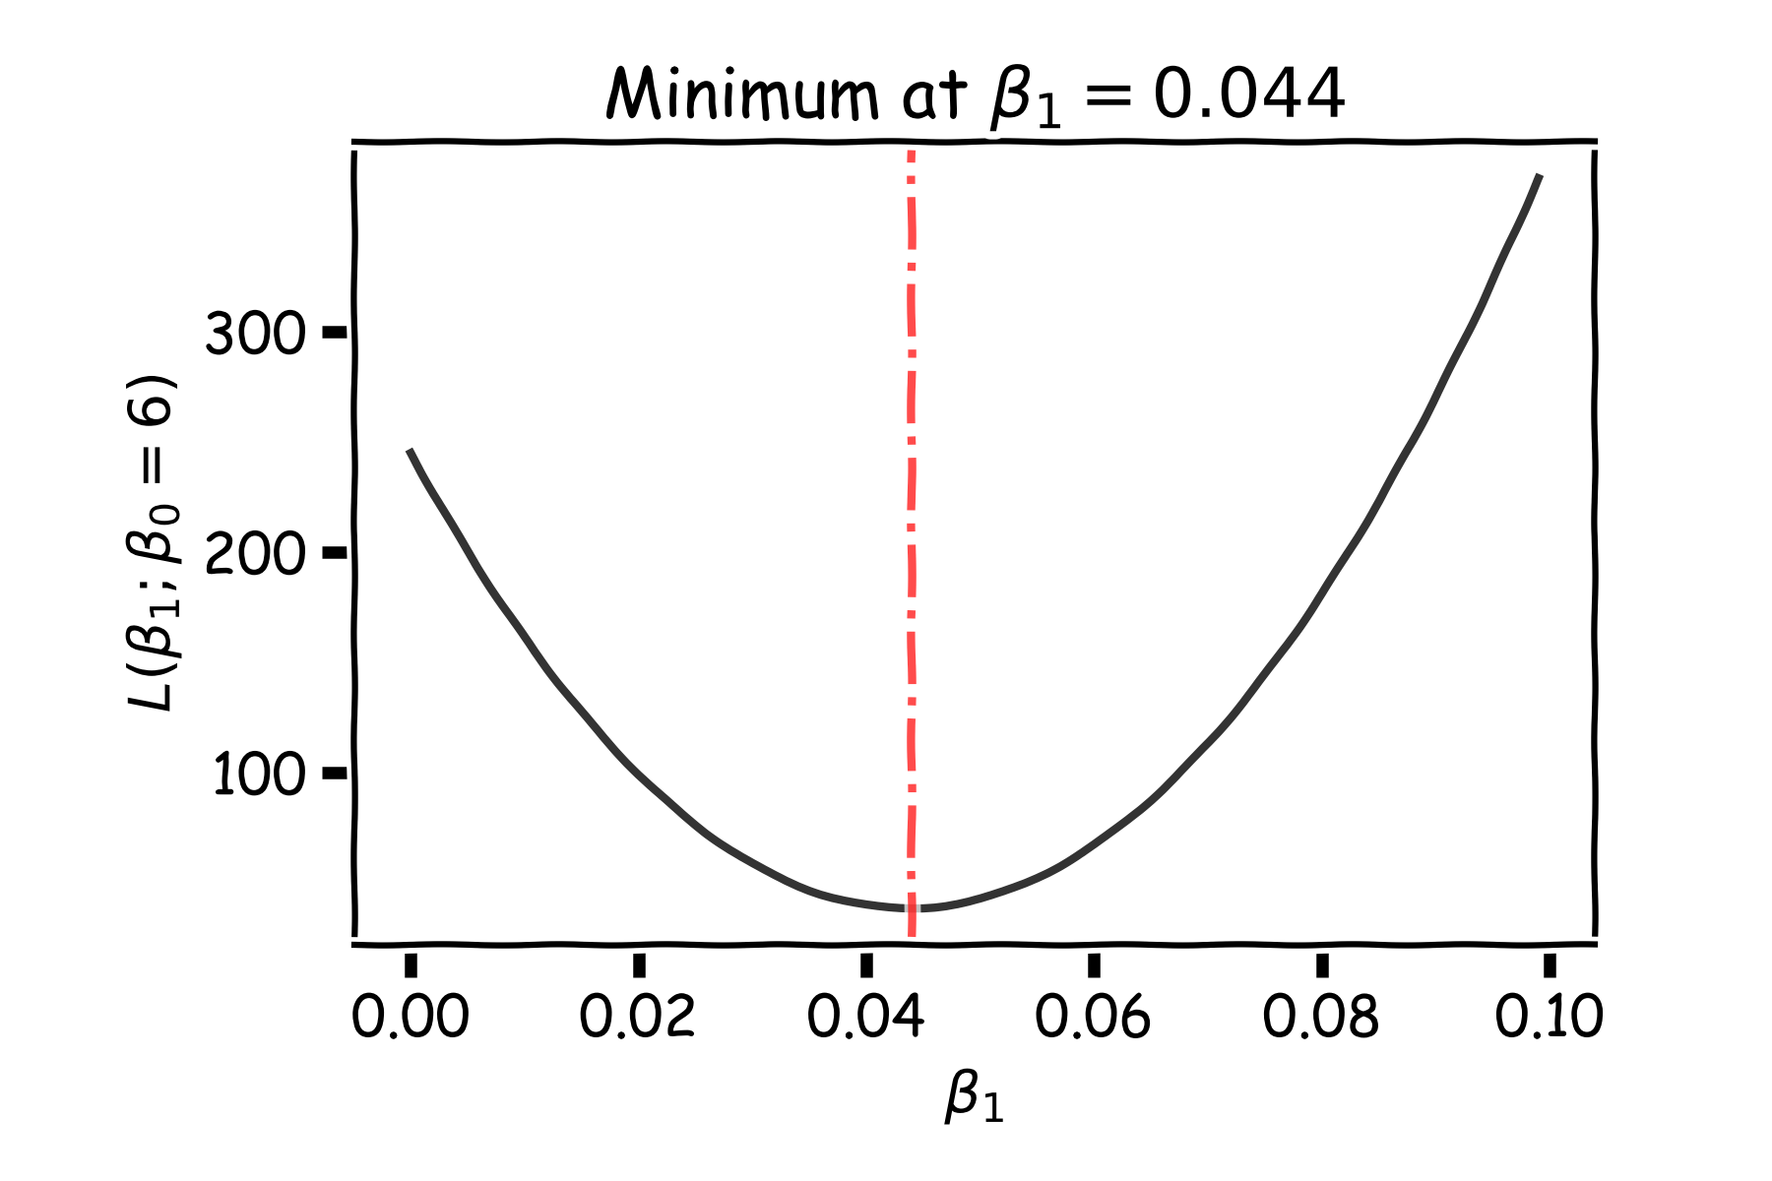
Estimate of the regression coefficients: brute force
A way to estimate is to calculate the loss function for every possible beta_0 and beta_1 . Then select the betas where the loss function is at the minimum.
E.g. the loss function for different beta_1s when beta_0 is fixed to be 6:
Notes:
Shall I add a contour plot?

Slide 19
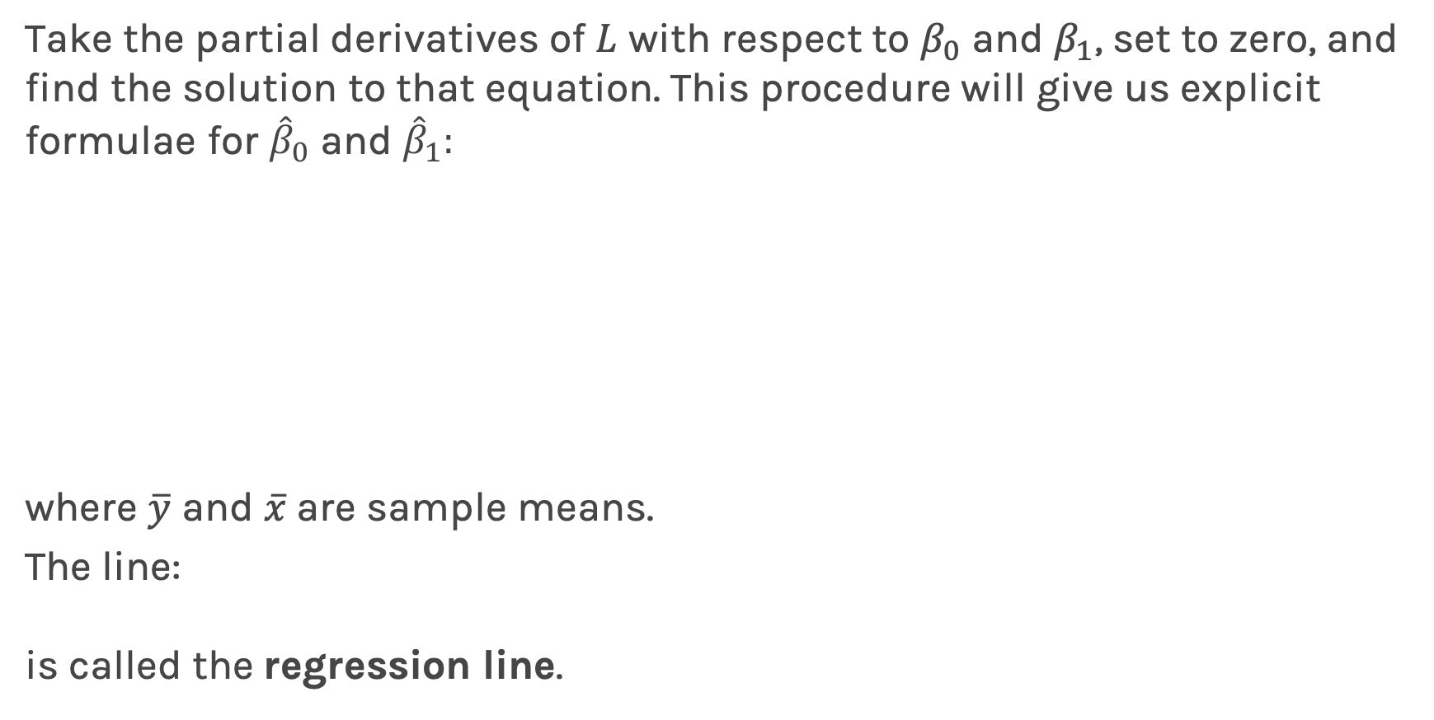
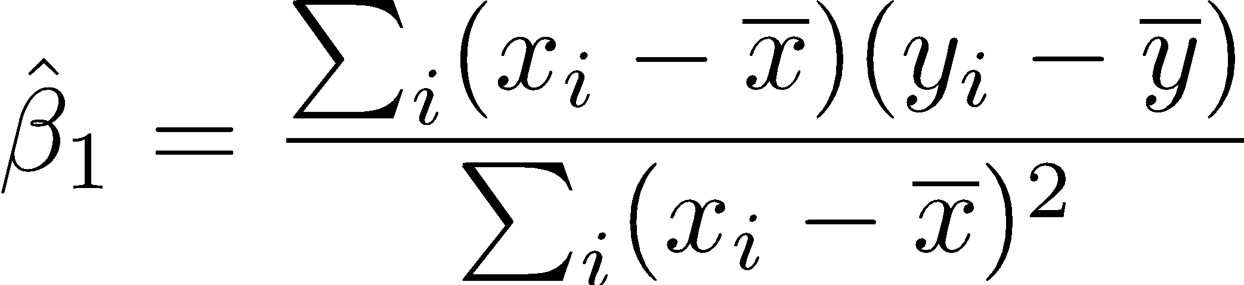
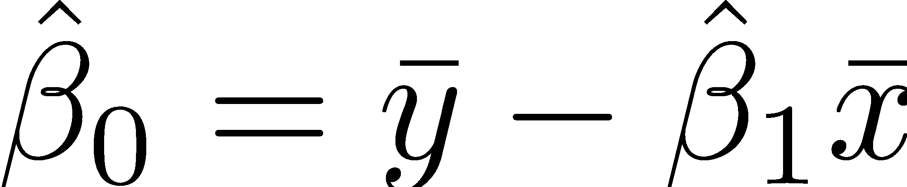
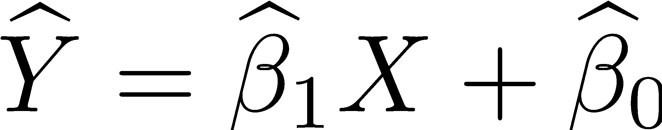
Estimate of the regression coefficients: exact method

Slide 20
Uncertainty in model and prediction
Cross validation
Overfitting: Variance & Bias
Pandas
NumPy
Scikit-Learn
PCA & dimensionality reduction
Statistical Learning
Computing Tools
Matplotlib
Methods of regularization:
Lasso and Ridge
Regression
Classification
Logistic
Linear
Trees
KNN
Neural Networks

Slide 21
Uncertainty in model and prediction
Cross validation
Overfitting: Variance & Bias
Pandas
NumPy
Scikit-Learn
PCA & dimensionality reduction
Statistical Learning
Computing Tools
Matplotlib
Methods of regularization:
Lasso and Ridge
Regression
Classification
Logistic
Linear
Trees
KNN
Neural Networks

Slide 22
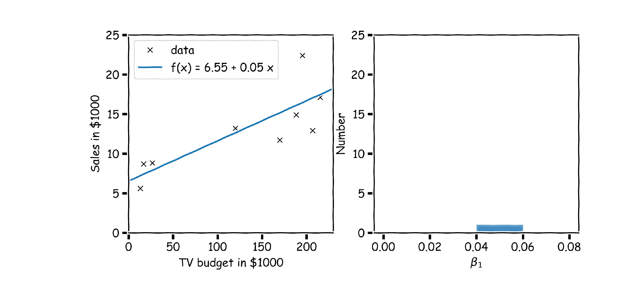
Confidence intervals for the predictors estimates (cont)
In our magical realisms, we can now sample multiple times

Slide 23
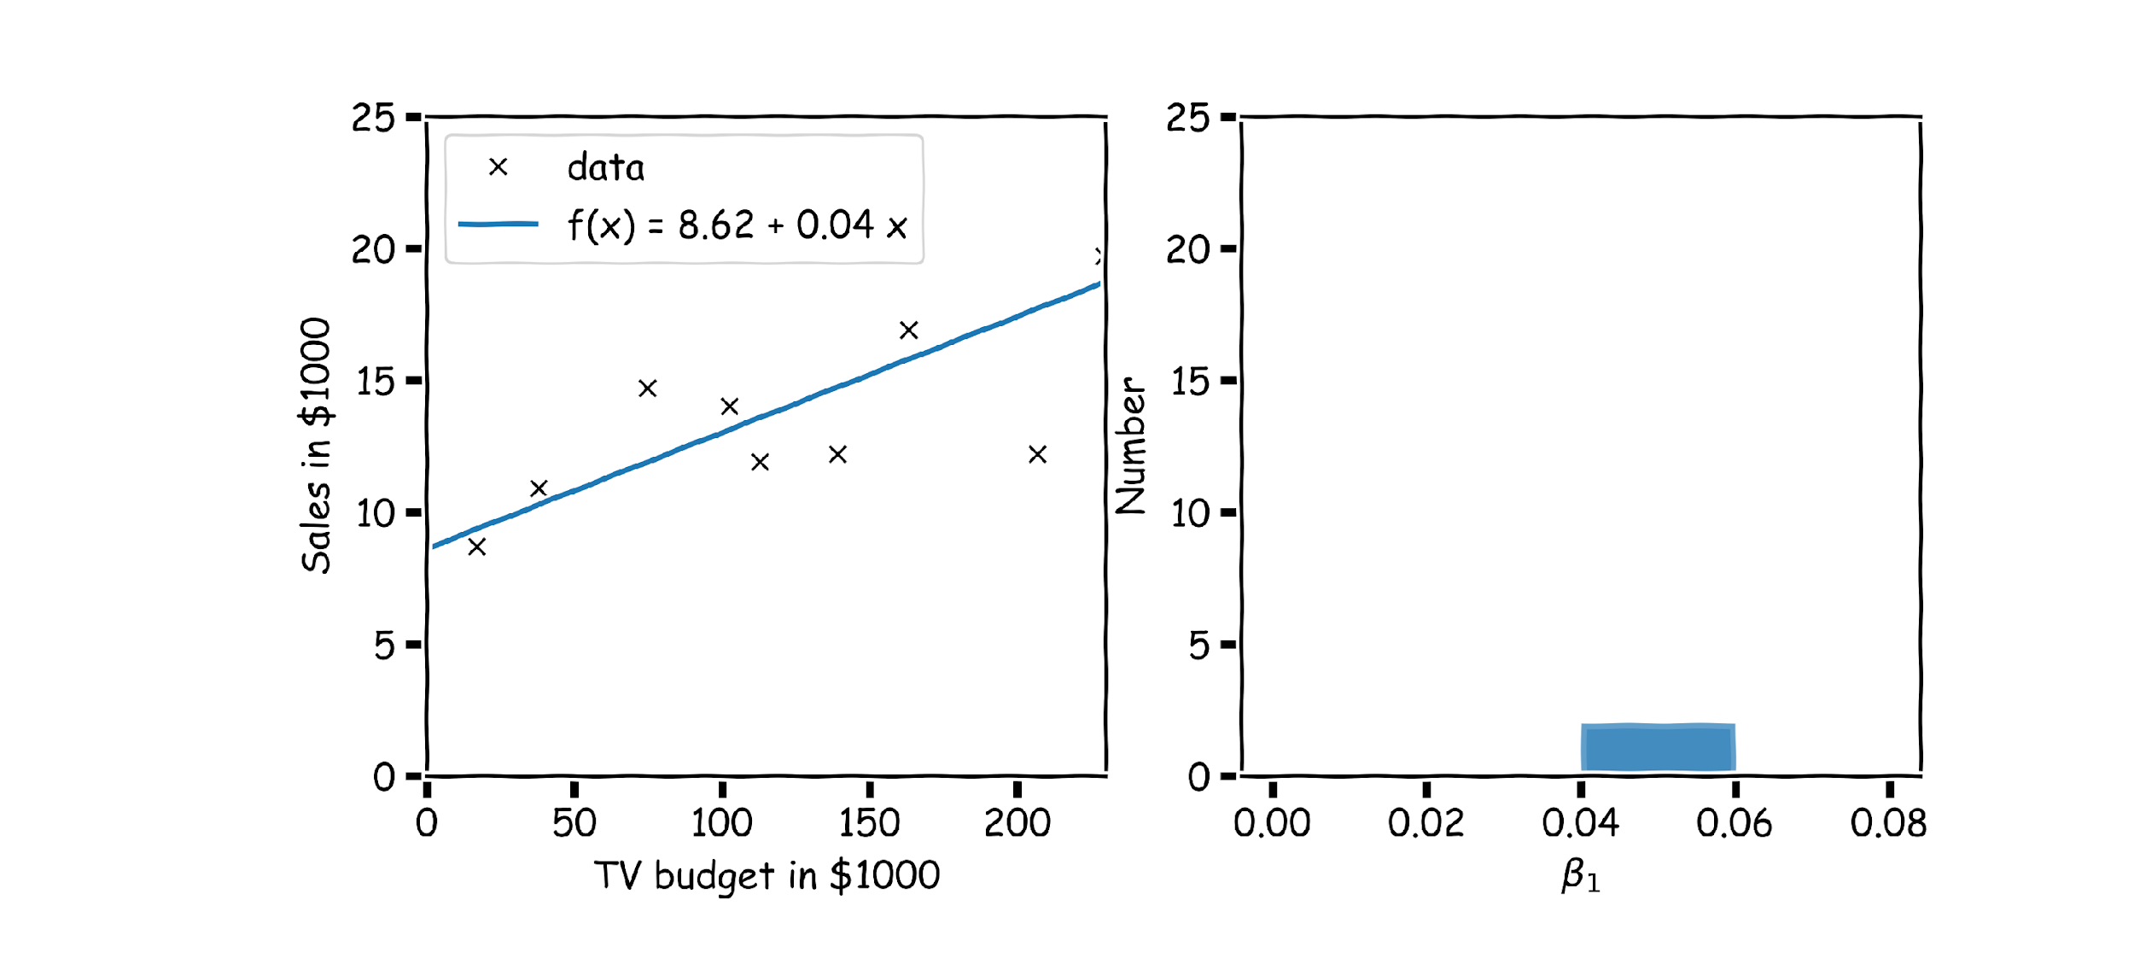
Confidence intervals for the predictors estimates (cont)
Another sample

Slide 24
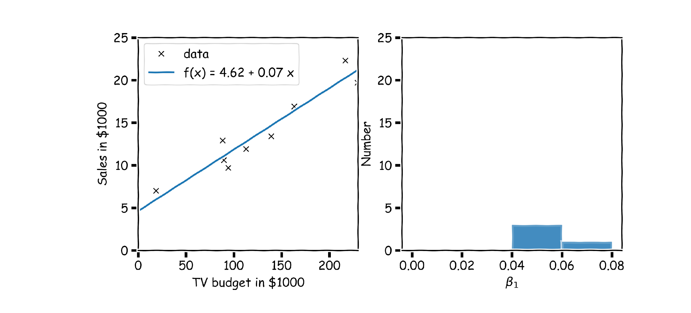
Confidence intervals for the predictors estimates (cont)
Another sample

Slide 25
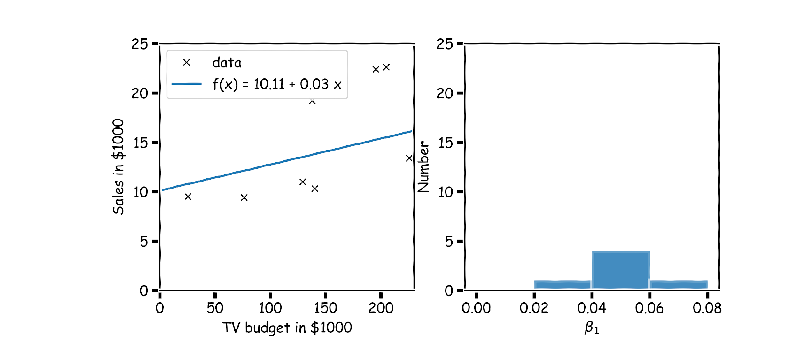
Confidence intervals for the predictors estimates (cont)
And another sample

Slide 26
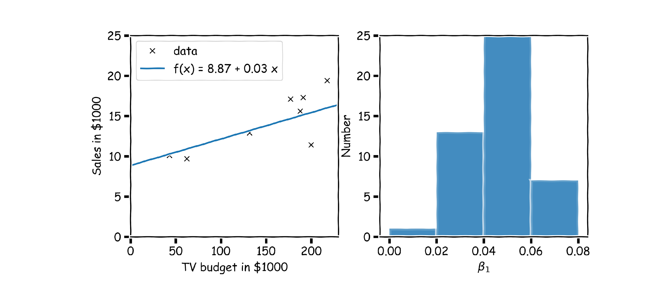
Confidence intervals for the predictors estimates (cont)
Repeat this for 100 times

Slide 27
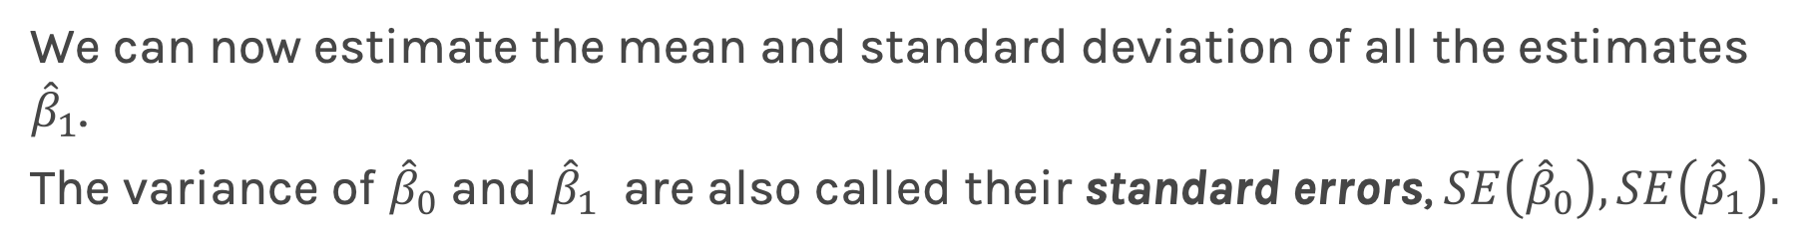
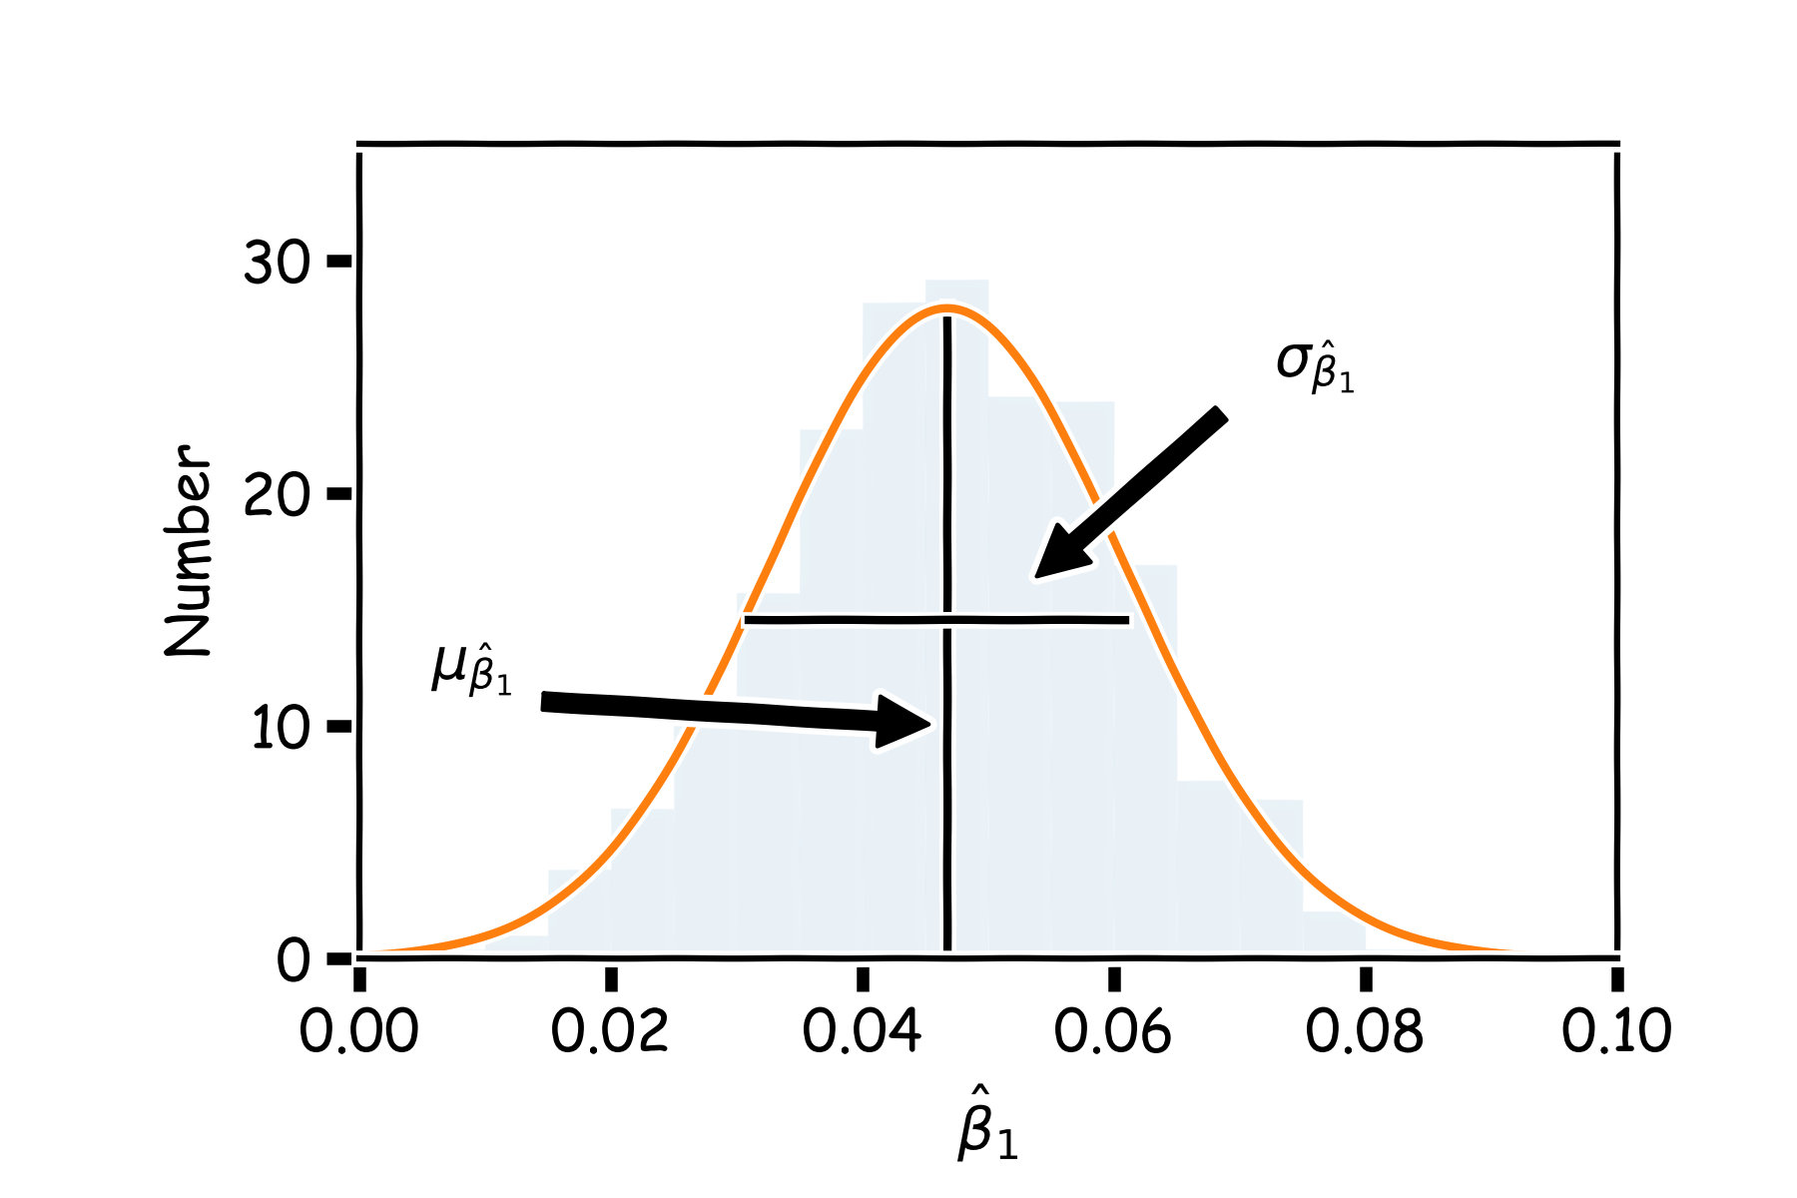
Confidence intervals for the predictors estimates (cont)
2

Slide 28
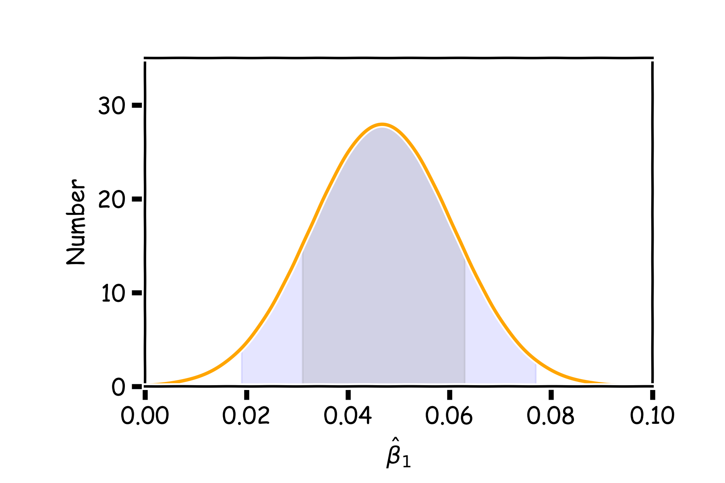
Confidence intervals for the predictors estimates (cont)
Finally we can calculate the confidence intervals, which are the ranges of values such that the true value of is contained in this interval with n percent probability.
95%
68%

Slide 29
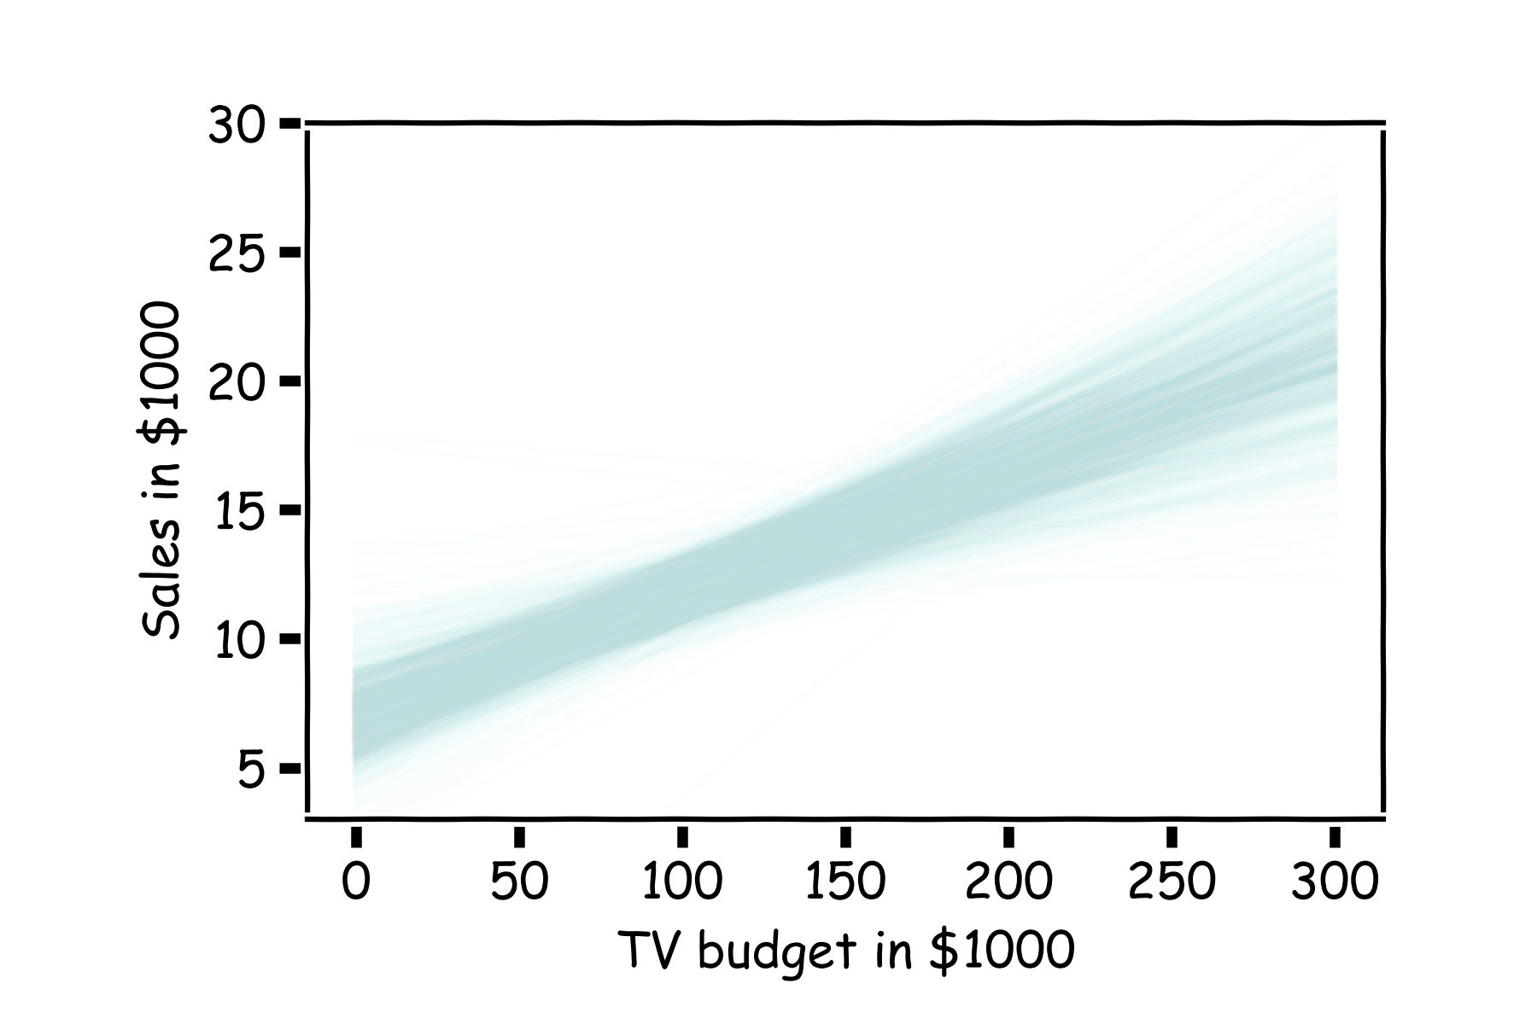
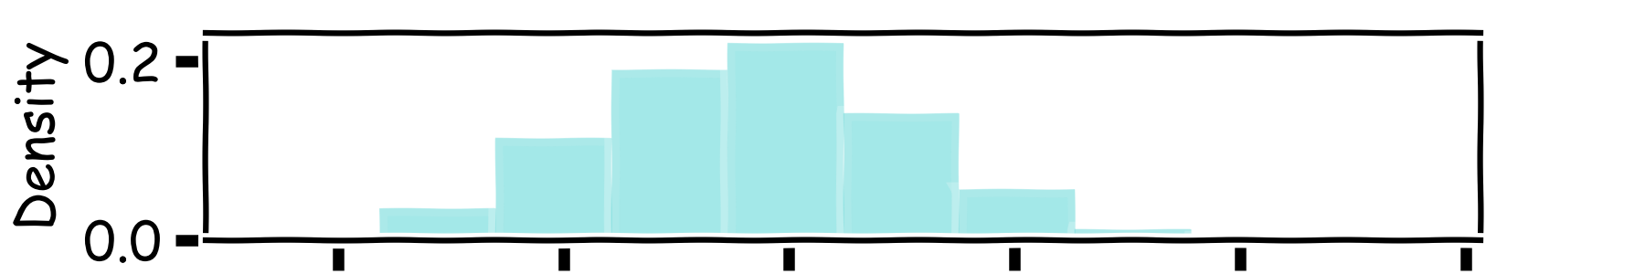
Below we show all regression lines for a thousand of such bootstrapped samples.

Slide 30
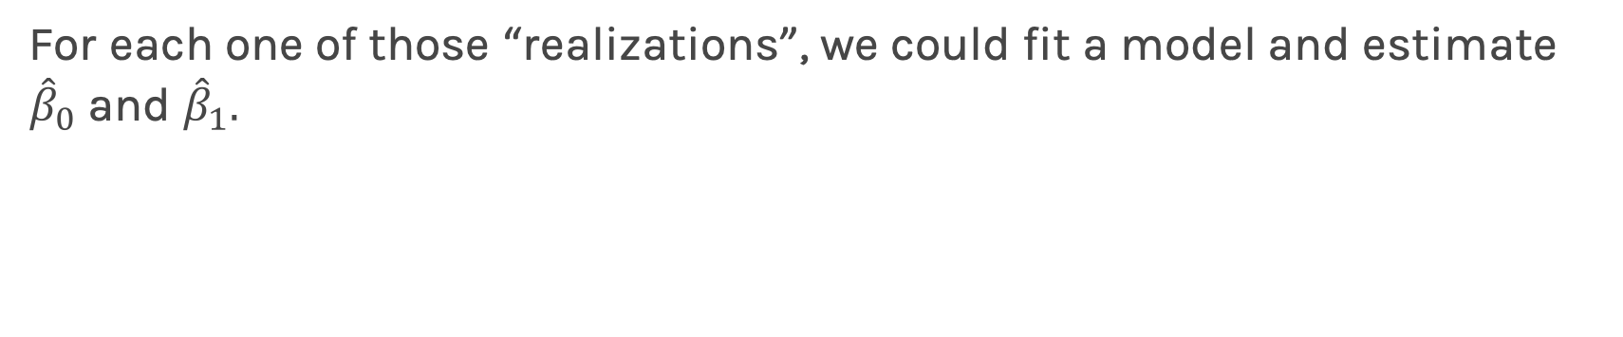
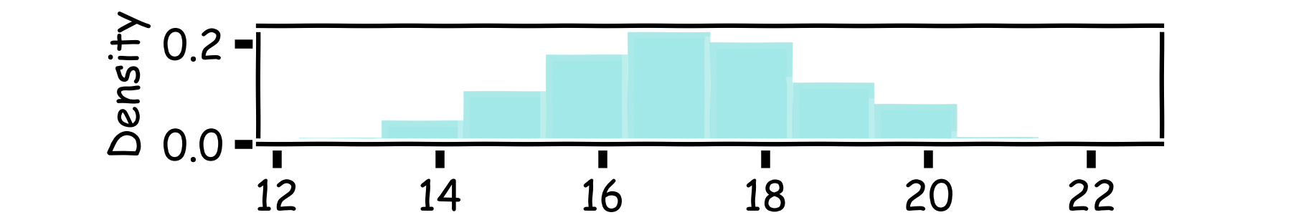
Below we show all regression lines for a thousand of such sub-samples.

Slide 31
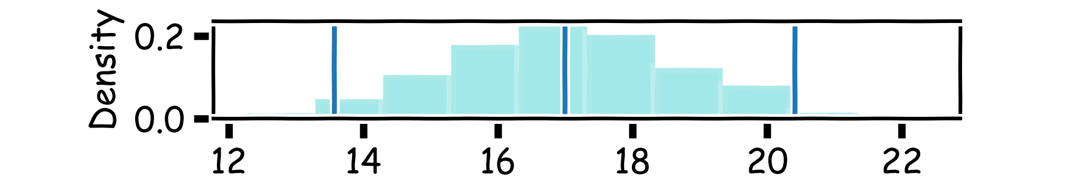
Below we show all regression lines for a thousand of such sub-samples.

Slide 32
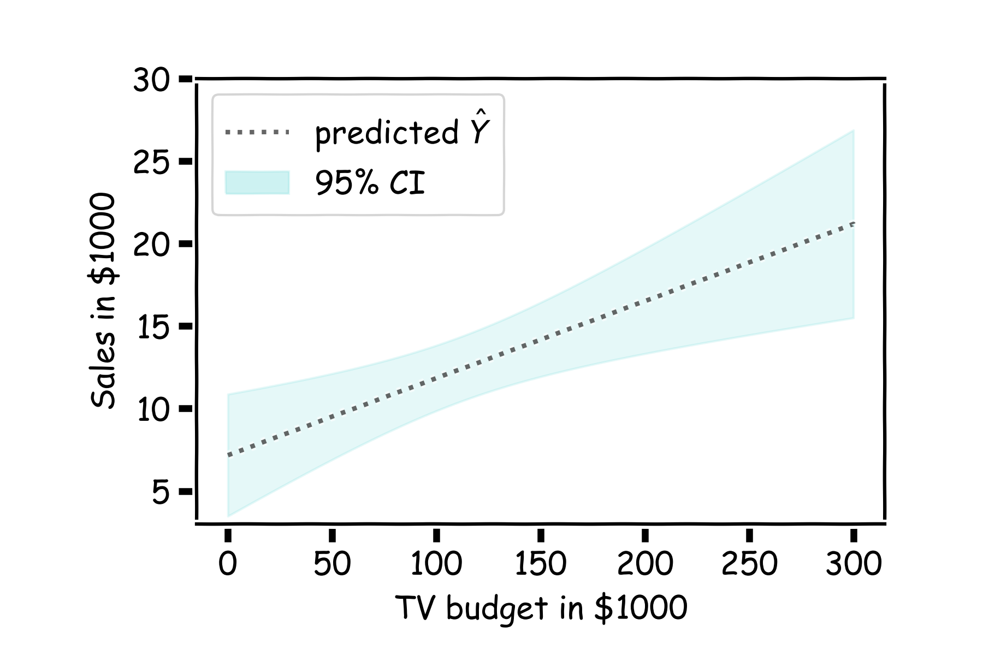
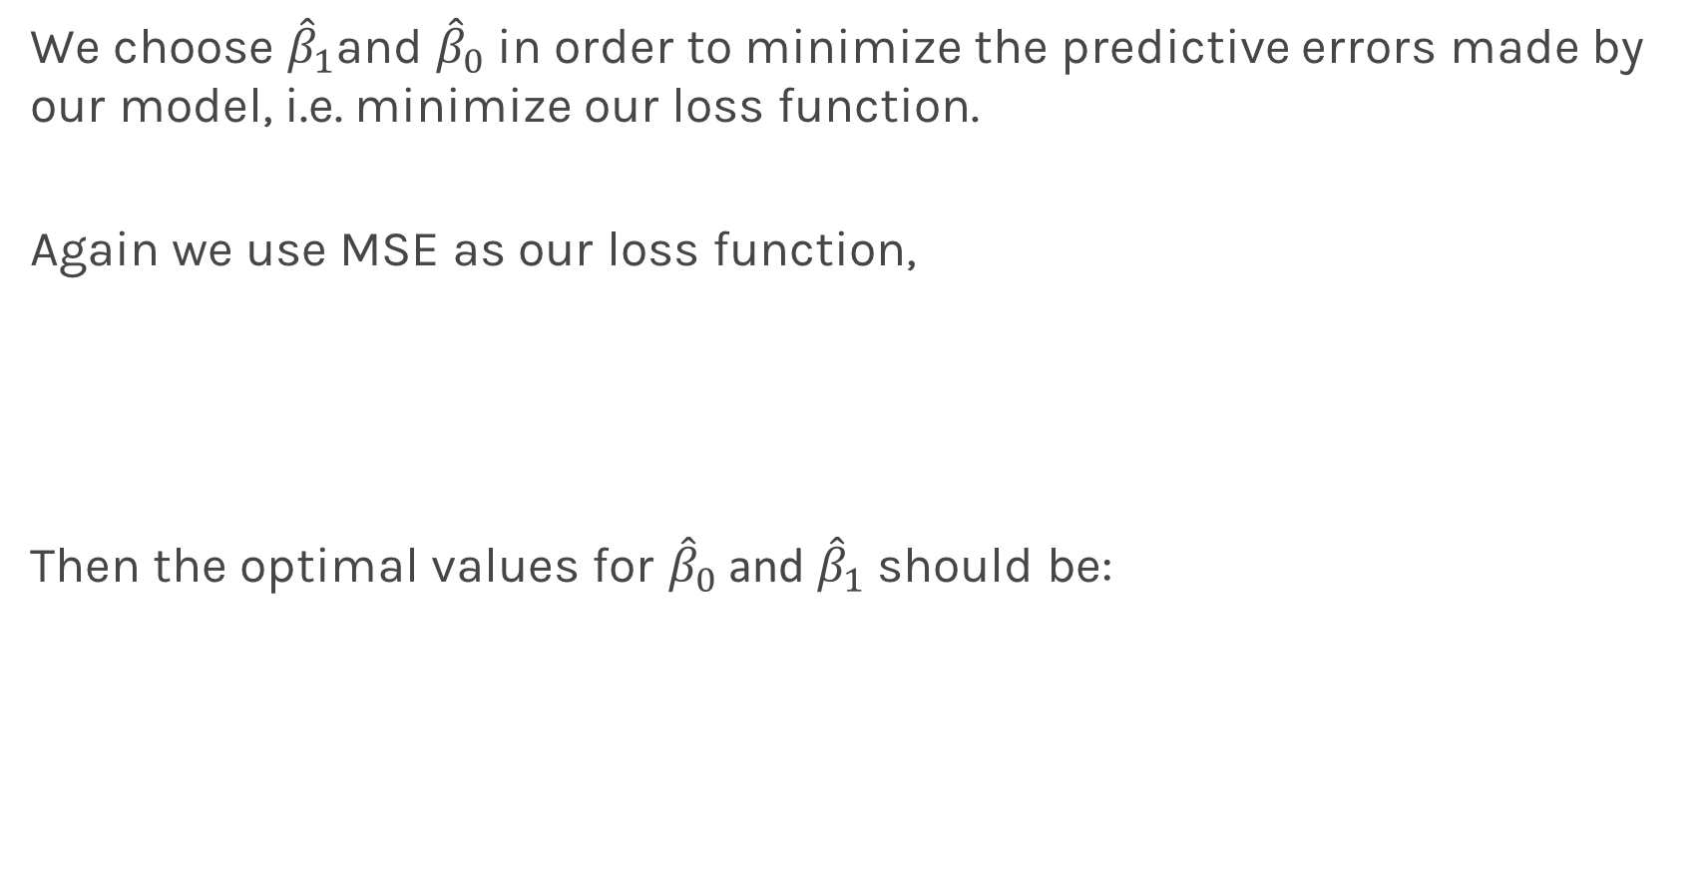

Slide 33
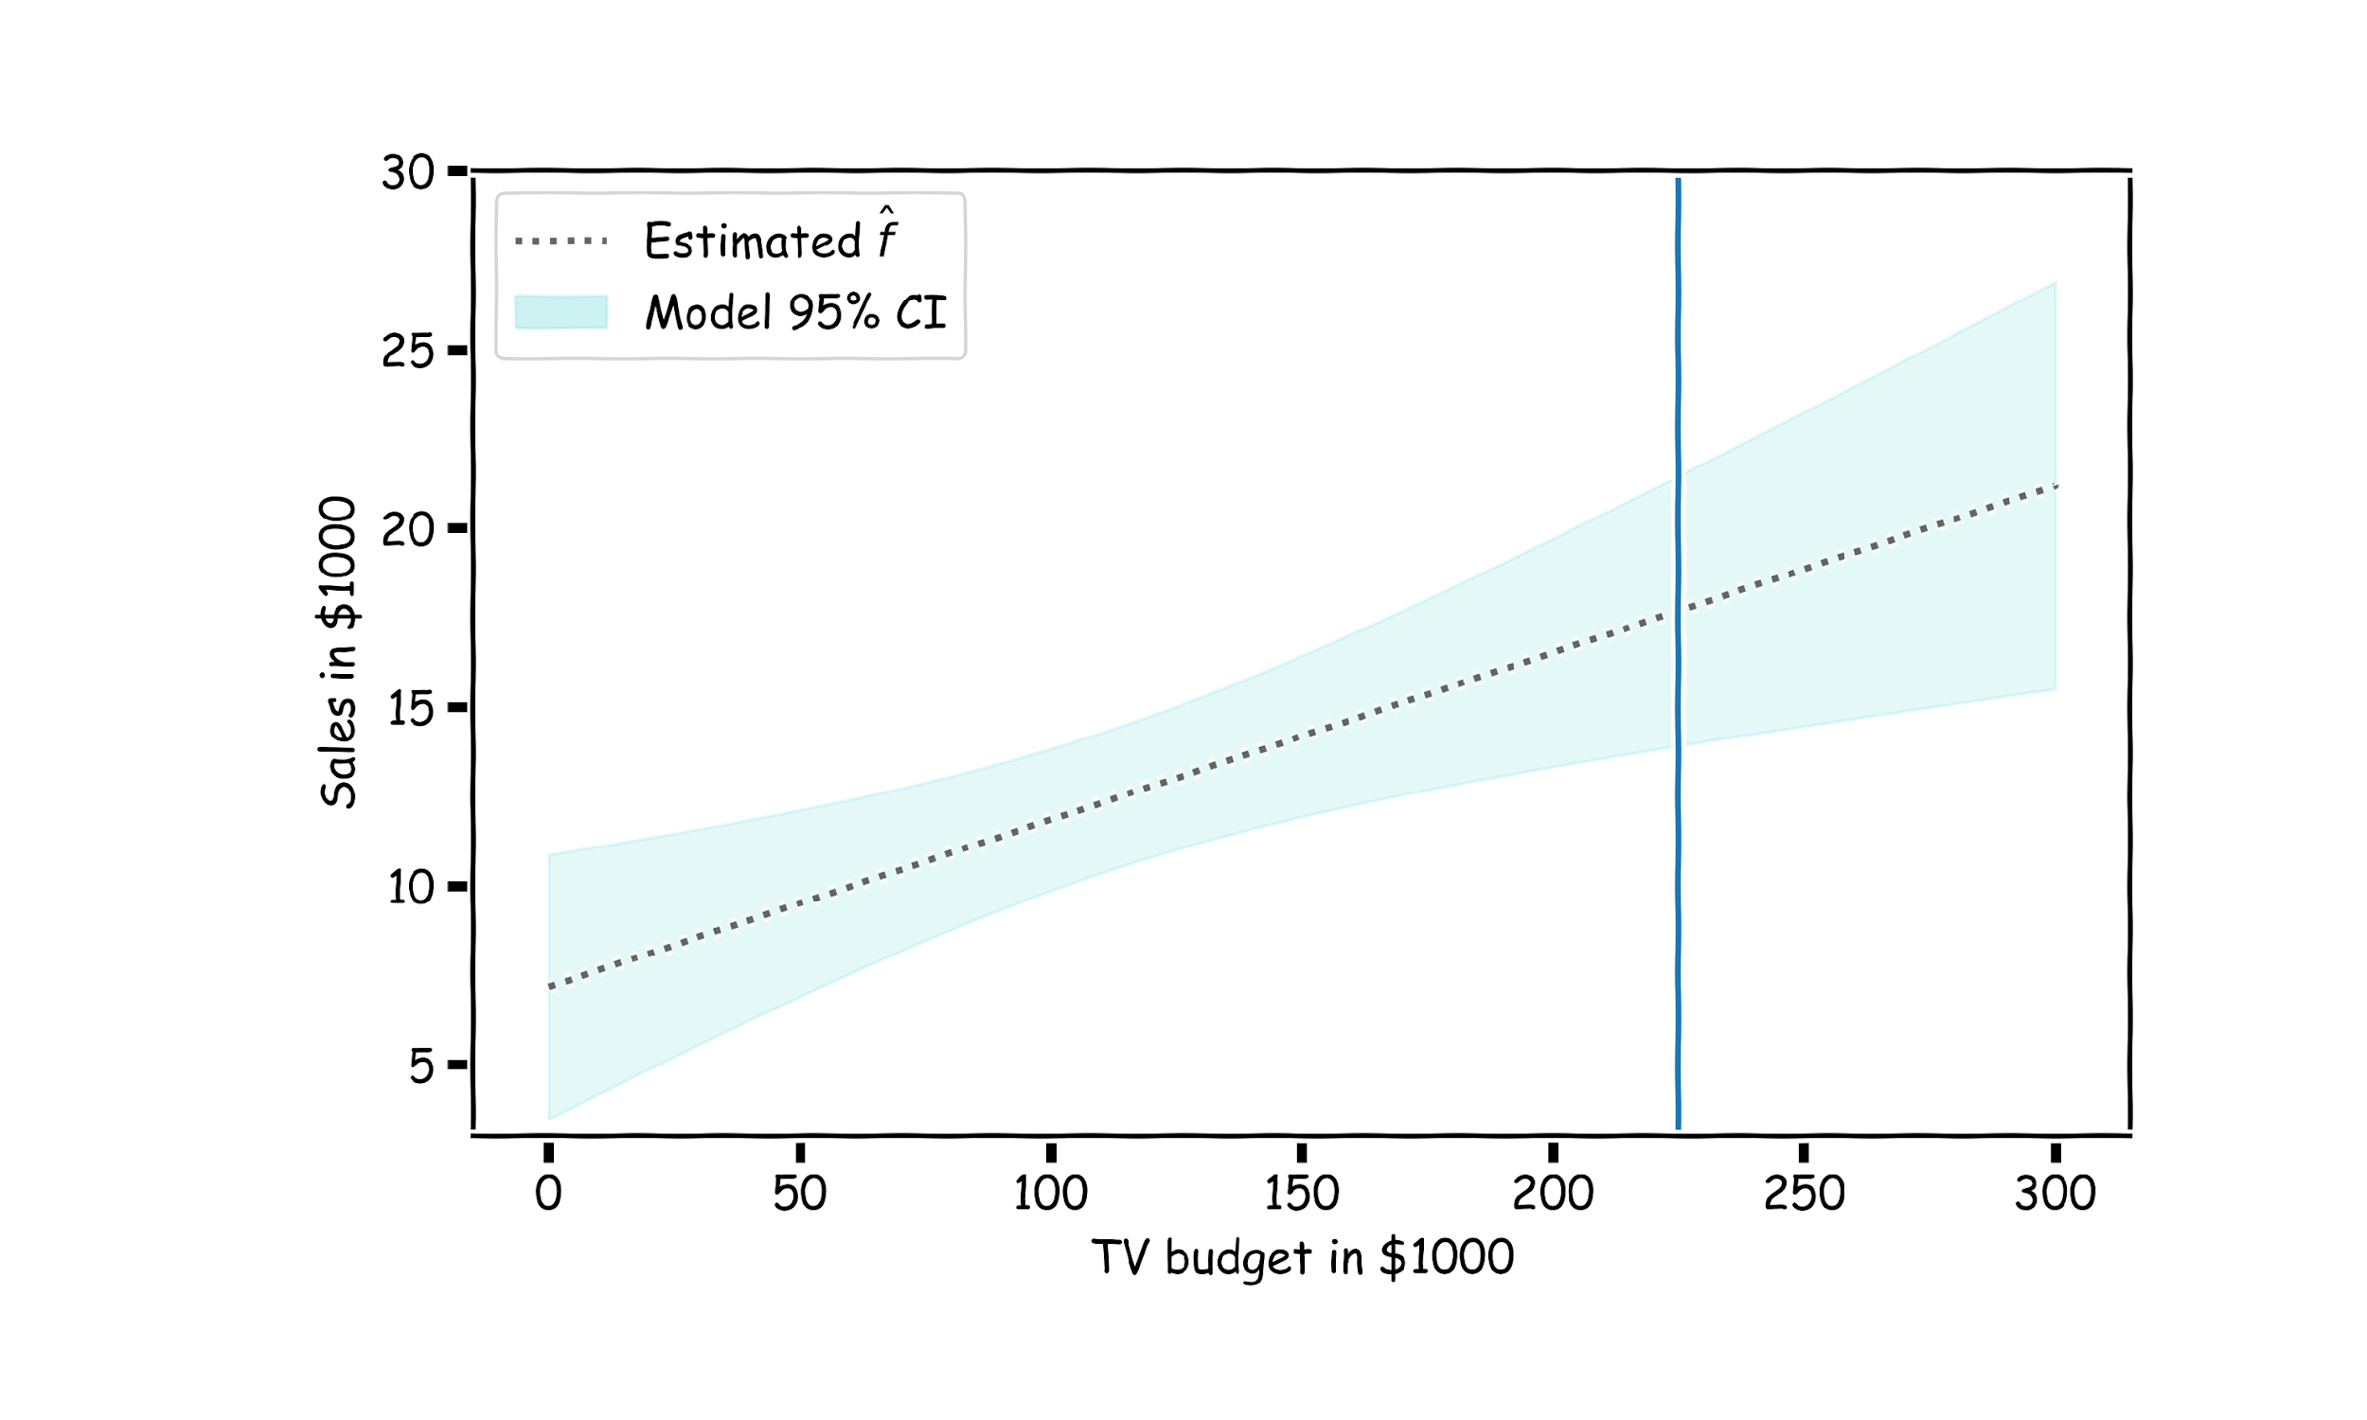

Slide 34


Slide 35
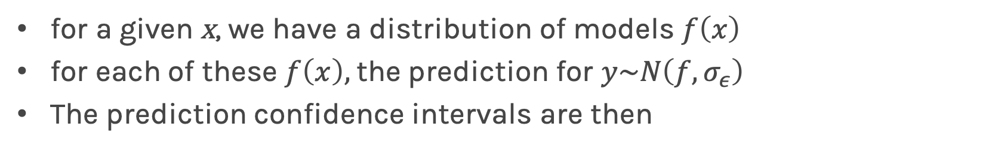
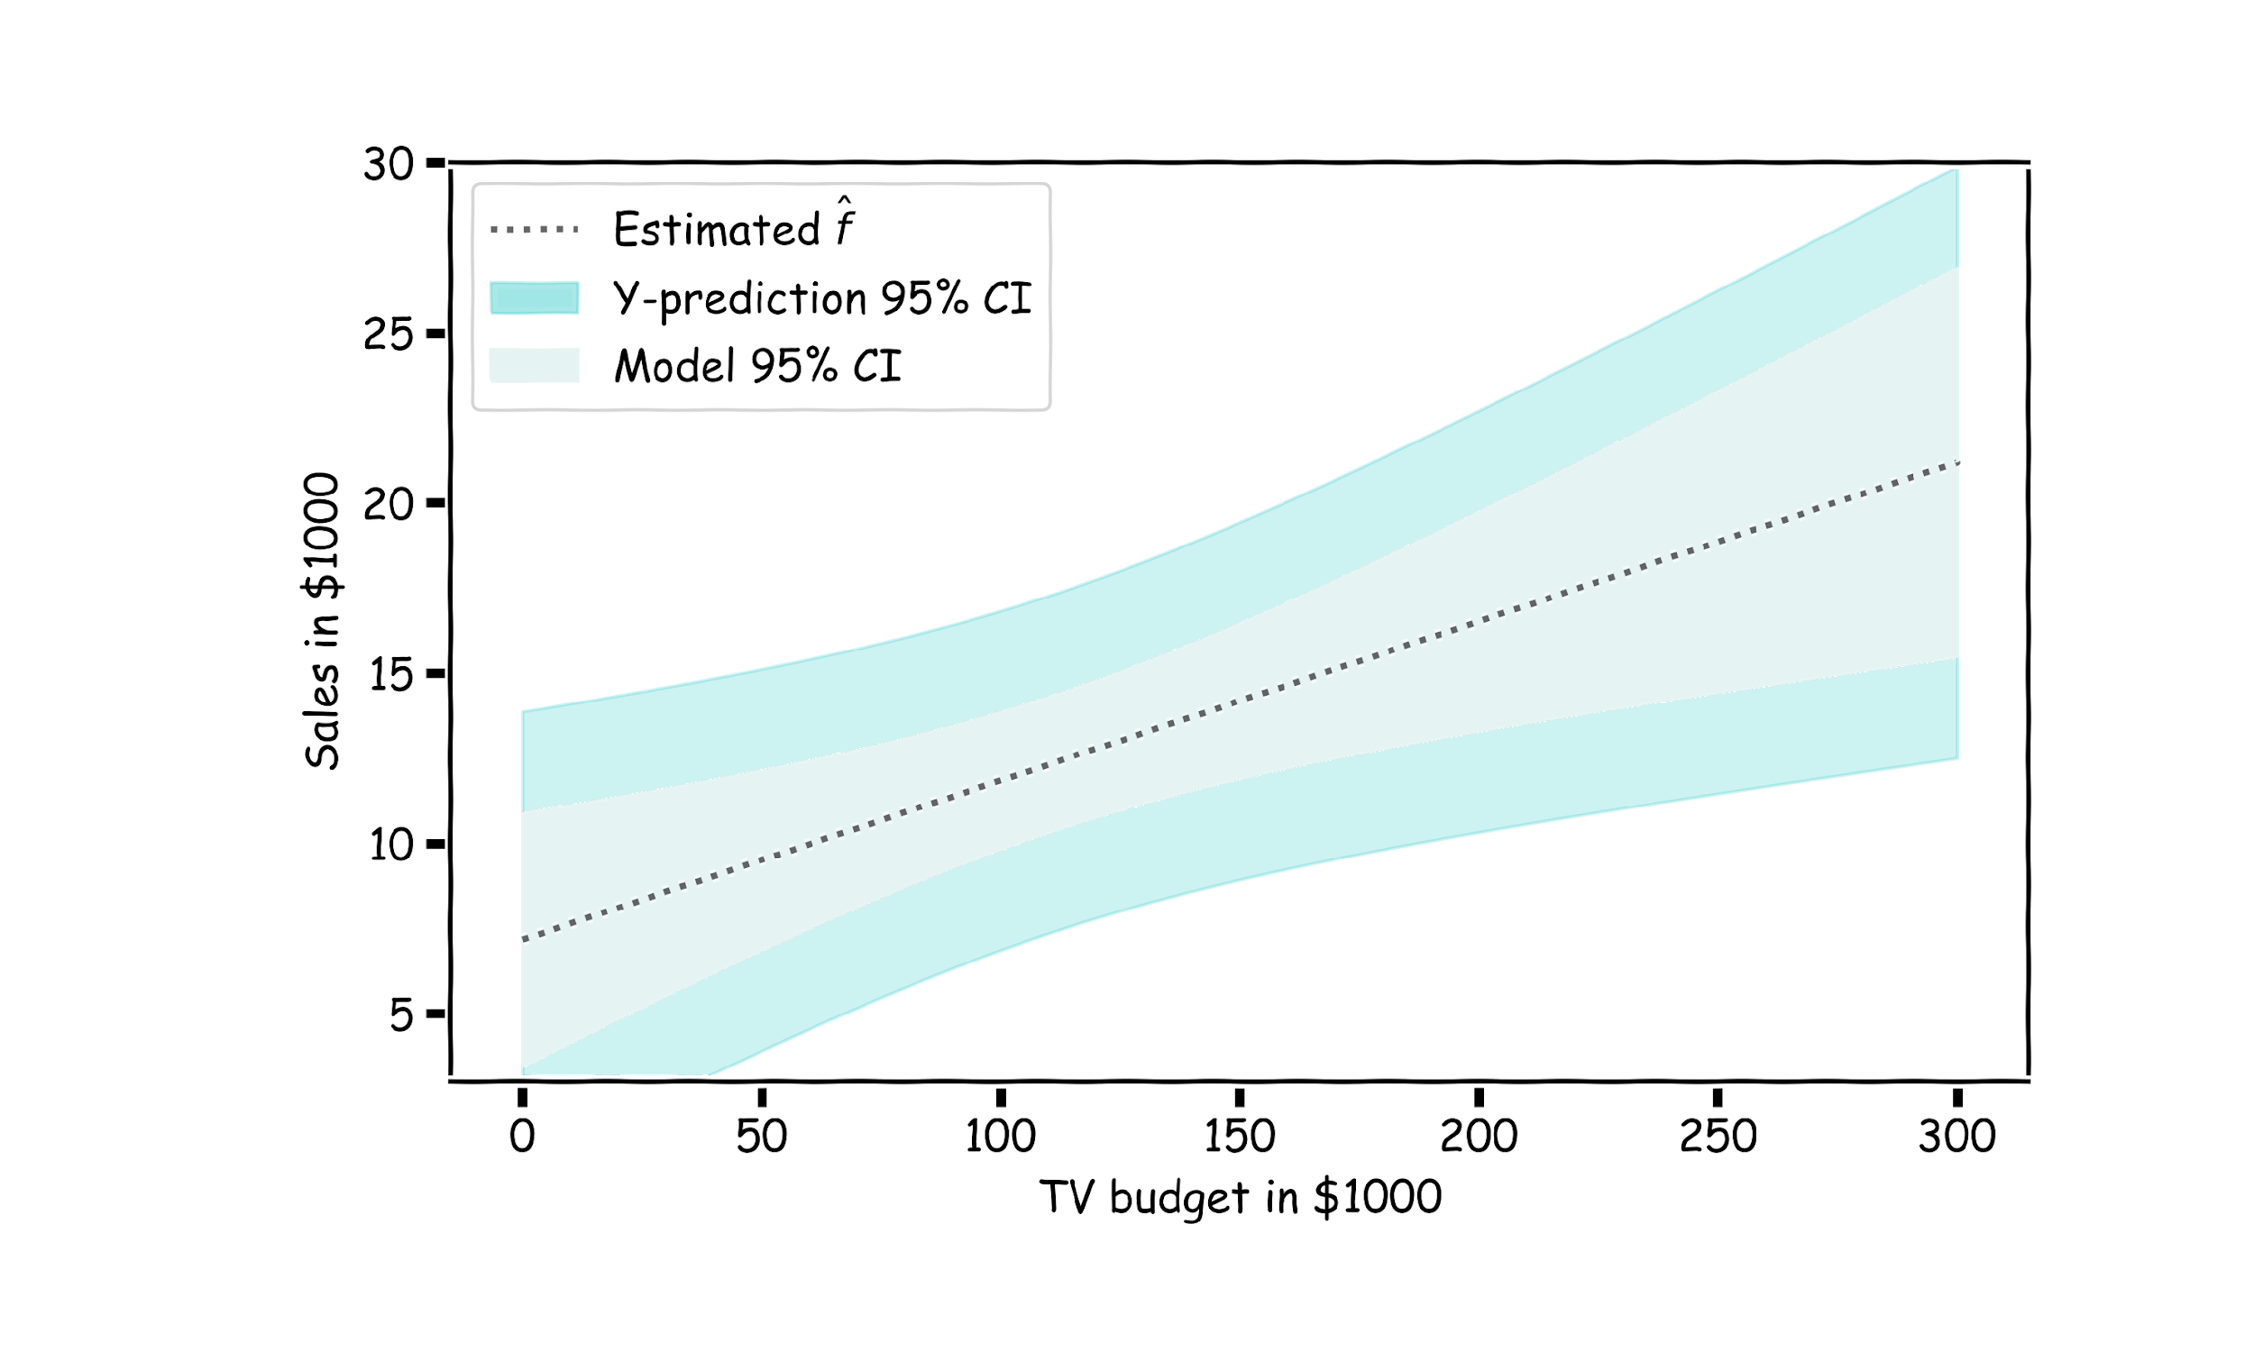

Slide 36
Uncertainty in model and prediction
Cross validation
Overfitting: Variance & Bias
Pandas
NumPy
Scikit-Learn
PCA & dimensionality reduction
Statistical Learning
Computing Tools
Matplotlib
Methods of regularization:
Lasso and Ridge
Regression
Classification
Logistic
Linear
Trees
KNN
Neural Networks

Slide 37
Uncertainty in model and prediction
Cross validation
Overfitting: Variance & Bias
Pandas
NumPy
Scikit-Learn
PCA & dimensionality reduction
Statistical Learning
Computing Tools
Matplotlib
Methods of regularization:
Lasso and Ridge
Regression
Classification
Logistic
Linear
Trees
KNN
Neural Networks

Slide 38
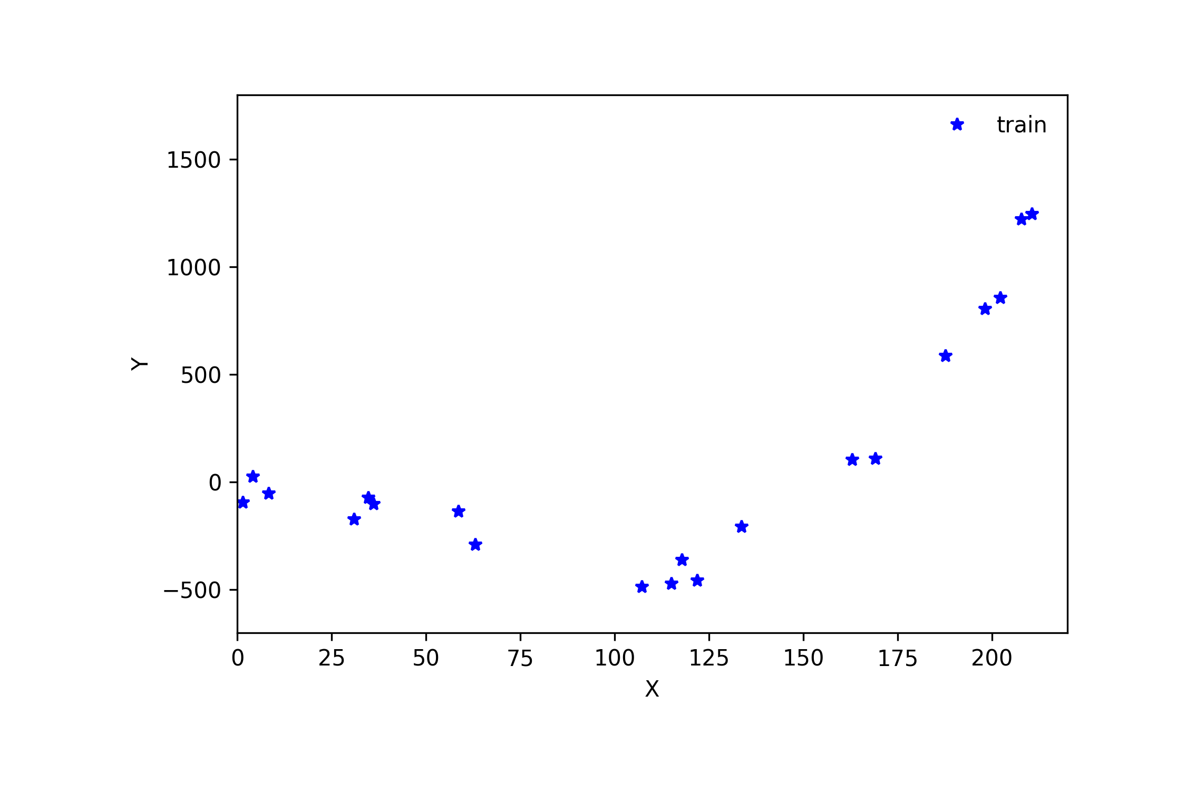
Cross Validation

Slide 39
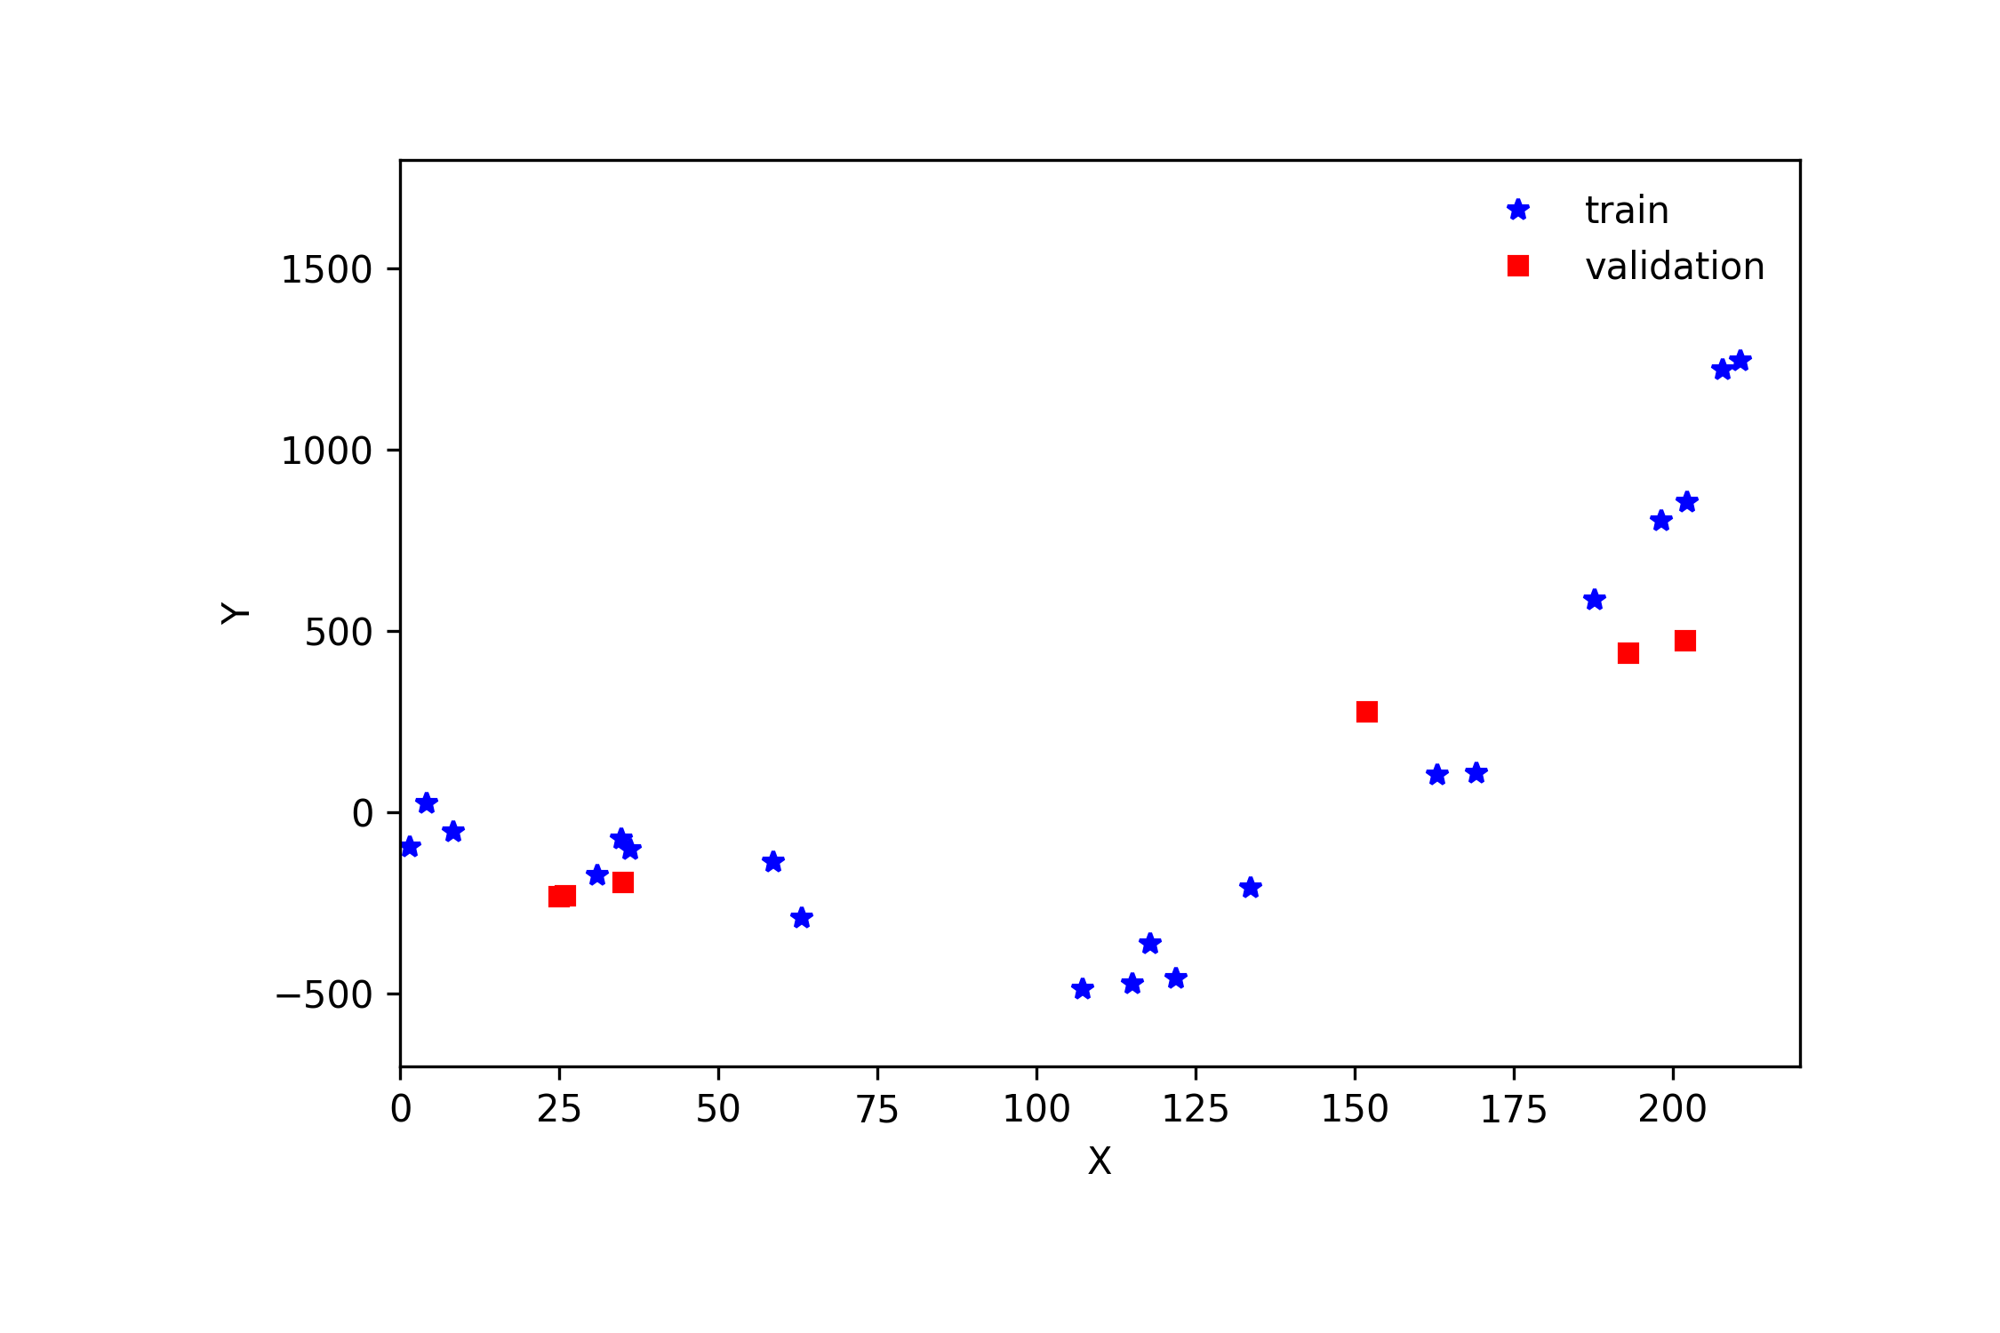
Cross Validation

Slide 40
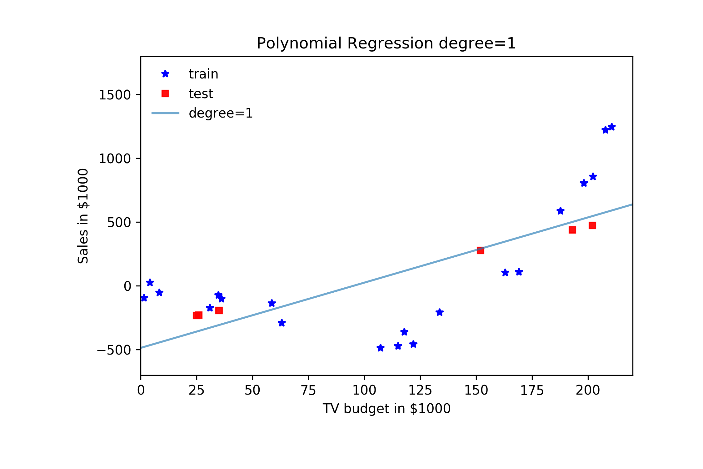
Cross Validation

Slide 41
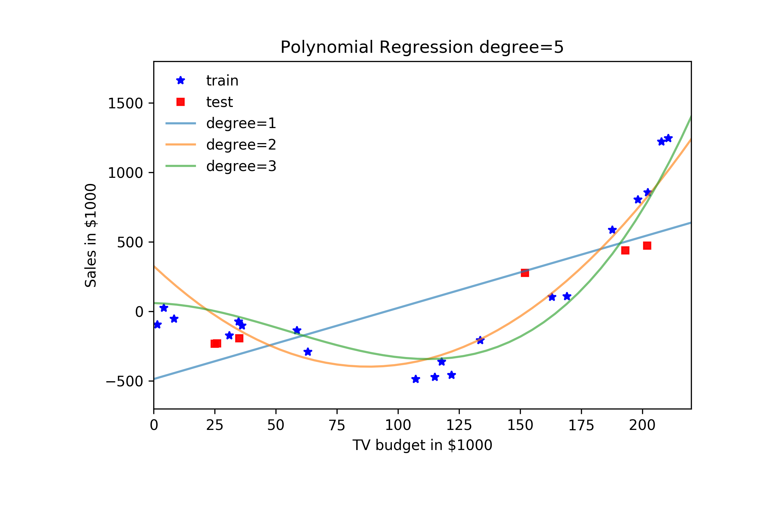
Cross Validation

Slide 42
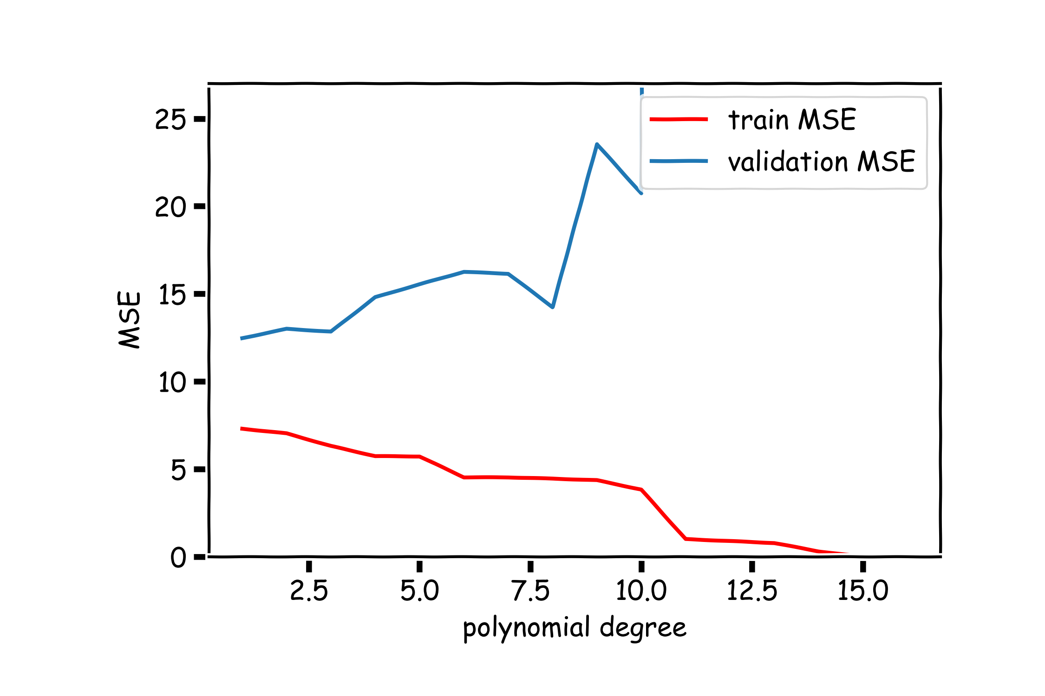
Validation

Slide 43
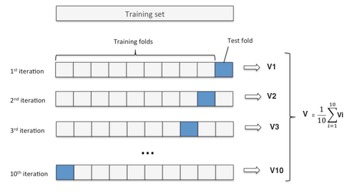
Cross Validation

Slide 44
Uncertainty in model and prediction
Cross validation
Overfitting: Variance & Bias
Pandas
NumPy
Scikit-Learn
PCA & dimensionality reduction
Statistical Learning
Computing Tools
Matplotlib
Methods of regularization:
Lasso and Ridge
Regression
Classification
Logistic
Linear
Trees
KNN
Neural Networks

Slide 45
Uncertainty in model and prediction
Cross validation
Overfitting: Variance & Bias
Pandas
NumPy
Scikit-Learn
PCA & dimensionality reduction
Statistical Learning
Computing Tools
Matplotlib
Methods of regularization:
Lasso and Ridge
Regression
Classification
Logistic
Linear
Trees
KNN
Neural Networks

Slide 46


Slide 47


Slide 48
Uncertainty in model and prediction
Cross validation
Overfitting: Variance & Bias
Pandas
NumPy
Scikit-Learn
PCA & dimensionality reduction
Statistical Learning
Computing Tools
Matplotlib
Methods of regularization:
Lasso and Ridge
Regression
Classification
Logistic
Linear
Trees
KNN
Neural Networks

Slide 49
Uncertainty in model and prediction
Cross validation
Overfitting: Variance & Bias
Pandas
NumPy
Scikit-Learn
PCA & dimensionality reduction
Statistical Learning
Computing Tools
Matplotlib
Methods of regularization:
Lasso and Ridge
Regression
Classification
Logistic
Linear
Trees
KNN
Neural Networks

Slide 50

Bias vs Variance

Slide 51

Bias vs Variance

Slide 52

Bias vs Variance

Slide 53

Linear models: 20 data points per line 2000 simulations

Slide 54

Bias vs Variance

Slide 55

Bias vs Variance

Slide 56

Bias vs Variance

Slide 57

Poly 10 degree models : 20 data points per line 2000 simulations

Slide 58
Bias vs Variance
Left: 2000 best fit straight lines, each fitted on a different 20 point training set.
Right: Best-fit models using degree 10 polynomial

Slide 59

Regularization: An Overview

Slide 60



LASSO Regression
Since we wish to discourage extreme values in model parameter, we need to choose a regularization term that penalizes parameter magnitudes. For our loss function, we will again use MSE.
Together our regularized loss function is:
Note that is the l₁ norm of the vector β

Slide 61



Ridge Regression
Alternatively, we can choose a regularization term that penalizes the squares of the parameter magnitudes. Then, our regularized loss function is:
Note that is the l₂ norm of the vector β

Slide 62

Ridge regularization with validation only: step by step

Slide 63

Ridge regularization with validation only: step by step

Slide 64
Uncertainty in model and prediction
Cross validation
Overfitting: Variance & Bias
Pandas
NumPy
Scikit-Learn
PCA & dimensionality reduction
Statistical Learning
Computing Tools
Matplotlib
Methods of regularization:
Lasso and Ridge
Regression
Classification
Logistic
Linear
Trees
KNN
Neural Networks
Experimental Design & Causal Inference

Slide 65
Uncertainty in model and prediction
Cross validation
Overfitting: Variance & Bias
Pandas
NumPy
Scikit-Learn
PCA & dimensionality reduction
Statistical Learning
Computing Tools
Matplotlib
Methods of regularization:
Lasso and Ridge
Regression
Classification
Logistic
Linear
Trees
KNN
Neural Networks

Slide 66

The Intuition Behind PCA
Top PCA components capture the most of amount of variation (interesting features) of the data.
Each component is a linear combination of the original predictors - we visualize them as vectors in the feature space.

Slide 67

The Intuition Behind PCA (cont.)
Transforming our observed data means projecting our dataset onto the space defined by the top m PCA components, these components are our new predictors.

Slide 68
A Framework For Dimensionality Reduction
One way to reduce the dimensions of the feature space is to create a new, smaller set of predictors by taking linear combinations of the original predictors.
We choose Z₁, Z₂,…, Z_{m}, where $m≤p$ and where each Z_{i} is a linear combination of the original p predictors
$$Z_{i}=\sum_{j=1}^{p}{φ_{ji}X_{j}}$$
for fixed constants $φ_{ji}$. Then we can build a linear regression regression model using the new predictors
$$Y=β_{0}+β_{1}Z_{1}+…+β_{m}Z_{m}+ε$$
Notice that this model has a smaller number (m+1 < p+1) of parameters.

Slide 69


The Math behind PCA
PCA is a well-known result from linear algebra. Let Z be the n x p matrix consisting of columns Z₁,…, Z_{p} (the resulting PCA vectors), X be the n x p matrix of X₁,…, X_{p} of the original data variables (each standardized to have mean zero and variance one, and without the intercept), and let W be the p x p matrix whose columns are the eigenvectors of the square matrix X$T$X, then:

Slide 70
Uncertainty in model and prediction
Cross validation
Overfitting: Variance & Bias
Pandas
NumPy
Scikit-Learn
PCA & dimensionality reduction
Statistical Learning
Computing Tools
Matplotlib
Methods of regularization:
Lasso and Ridge
Regression
Classification
Logistic
Linear
Trees
KNN
Neural Networks

Slide 71
Uncertainty in model and prediction
Cross validation
Overfitting: Variance & Bias
Pandas
NumPy
Scikit-Learn
PCA & dimensionality reduction
Statistical Learning
Computing Tools
Matplotlib
Methods of regularization:
Lasso and Ridge
Regression
Classification
Logistic
Linear
Trees
KNN
Neural Networks

Slide 72
Uncertainty in model and prediction
Cross validation
Overfitting: Variance & Bias
Pandas
NumPy
Scikit-Learn
PCA & dimensionality reduction
Statistical Learning
Computing Tools
Matplotlib
Methods of regularization:
Lasso and Ridge
Regression
Classification
Logistic
Linear
Trees
KNN
Neural Networks

Slide 73
Uncertainty in model and prediction
Cross validation
Overfitting: Variance & Bias
Pandas
NumPy
Scikit-Learn
PCA & dimensionality reduction
Statistical Learning
Computing Tools
Matplotlib
Methods of regularization:
Lasso and Ridge
Regression
Classification
Logistic
Linear
Trees
KNN
Neural Networks

Slide 74

Even Simpler Classification Problem: Binary Response (cont)
What could go wrong with this linear regression model?
.

Slide 75



Pavlos Game #45
Think of a function that would do this for us
$$Y=f(x)$$

Slide 76




Logistic Regression
$$2β_{1}$$
$$−\frac{β_{0}}{β_{1}}$$
$$\frac{β_{1}}{4}$$

Slide 77


Estimation in Logistic Regression
Probability Mass Function (PMF):
$$P(Y=1)=p$$
$$P(Y=0)=1−p$$
$${P\left(Y=y\right)=p}^{y}{(1−p)}^{(1−y)}$$
where:
$$p=P\left(Y=1 | X=x\right)=\frac{1}{1+e^{−(β_{0}+β_{1}X)}}$$
and therefore $p$depends on X.
Thus not every $p_{i}$ is the same for each individual measurement.

Slide 78


Likelihood
The likelihood of a single observation for p given x and y is:
Given the observations are independent, what is the likelihood function for p?
$$L\left(p_{i} | Y_{i}\right)=P\left(Y_{i}=y_{i}\right)=p_{i}^{y_{i}}{\left(1−p_{i}\right)}^{1−y_{i}}$$
$$L\left(p | Y\right)=\prod_{i}{P\left(Y_{i}=y_{i}\right)=\prod_{i}{p_{i}^{y_{i}}{\left(1−p_{i}\right)}^{1−y_{i}}}}$$
$$l\left(p | Y\right)=−\log{L\left(p | Y\right)=}−\sum_{i}{y_{i}\log{p_{i}+\left(1−y_{i}\right)\log{(1−p_{i})}}}$$

Slide 79

Loss Function
$$l\left(p | Y\right)=−\sum_{i}{{\left\lfloor y_{i}\log{\frac{1}{1+e^{−(β_{0}+{β_{1}X}_{i})}}+\left(1−y_{i}\right)\log\left(1−\frac{1}{1+e^{−(β_{0}+{β_{1}X}_{i})}}\right)}\right\rfloor }_{i} }$$
How do we minimize this?
Differentiate, equate to zero and solve for it!
But jeeze does this look messy?! It will not necessarily have a closed form solution.
So how do we determine the parameter estimates? Through an iterative approach (we will talk about this at length in future lectures).

Slide 80

Classifier with two predictors
How can we estimate a classifier, based on logistic regression, for the following plot?

Slide 81

Multiple Logistic Regression
Earlier we saw the general form of simple logistic regression, meaning when there is just one predictor used in the model. What was the model statement (in terms of linear predictors)?
Multiple logistic regression is a generalization to multiple predictors. More specifically we can define a multiple logistic regression model to predict $P(Y=1)$ as such:

Slide 82


Regularization in Logistic Regression
A penalty factor can then be added to this loss function and results in a new loss function that penalizes large values of the parameters:
The result is just like in linear regression: shrink the parameter estimates towards zero.
In practice, the intercept is usually not part of the penalty factor.
Note: the sklearn package uses a different tuning parameter: instead of $λ$ they use a constant that is essentially $C=\frac{1}{λ}$.
$$\underset{β_{0},β_{1},…,β_{p}}{argmin}⁡\left[−\sum_{i=1}^{n}{\left(y_{i}\ln\left(p_{i}\right)+\left(1−y_{i}\right)\ln\left(1−p_{i}\right)\right)}+λ\sum_{j=1}^{p}{β_{j}^{2}}\right]$$

Slide 83

Diagnostic Testing in Classification (cont.)
Bayes’ theorem can be rewritten for classification:
$$P\left(y=1 | \hat{y}=1\right)=\frac{P\left(\hat{y}=1 | y=1\right)P(y=1)}{P\left(\hat{y}=1 | y=1\right)P(y=1)+P\left(\hat{y}=1 | y=0\right)P(y=0)}$$
These probability quantities can then be defined as:
Sensitivity: $P\left(\hat{y}=1 | y=1\right)$
Specificity: $P\left(\hat{y}=0 | y=0\right)$
Prevalence: $P(y=1)$
Positive Predictive Value: $P(y=1|\hat{y}=1)$
Negative Predictive Value: $P(y=0|\hat{y}=0)$
How do positive and negative predictive values relate? Be careful...

Slide 84
ROC Curve Example
The Radio Operator Characteristics (ROC) curve illustrates the trade-off for all possible thresholds chosen for the two types of error (or correct classification).
The vertical axis displays the true positive predictive value and the horizontal axis depicts the true negative predictive value.
The overall performance of a classifier, calculated over all possible thresholds, is given by the area under the ROC curve (AUC).
An ideal ROC curve will hug the top left corner, so the larger the AUC the better the classifier.

Slide 85

Multinomial Logistic Regression: the model
To predict K classes (K > 2) from a set of predictors X, a multinomial logistic regression can be fit:
$$\ln\left(\frac{P(Y=1)}{P(Y=K)}\right) =β_{0,1}+β_{1,1}X_{1}+β_{2,1}X_{2}+…+β_{p,1}X_{p}$$
$$\ln\left(\frac{P(Y=2)}{P(Y=K)}\right) =β_{0,2}+β_{1,2}X_{1}+β_{2,2}X_{2}+…+β_{p,2}X_{p}$$
$$⋮$$
$$\ln\left(\frac{P(Y=K−1)}{P(Y=K)}\right) =β_{0,K−1}+β_{1,K−1}X_{1}+β_{2,K−1}X_{2}+…+β_{p,K−1}X_{p}$$
Each separate model can be fit as independent standard logistic regression models!

Slide 86

One vs. Rest (OvR) Logistic Regression: the model
To predict K classes (K > 2) from a set of predictors X, a multinomial logistic regression can be fit:
$$\ln\left(\frac{P(Y=1)}{P(Y≠1)}\right) =β_{0,1}+β_{1,1}X_{1}+β_{2,1}X_{2}+…+β_{p,1}X_{p}$$
$$\ln\left(\frac{P(Y=2)}{P(Y≠2)}\right) =β_{0,2}+β_{1,2}X_{1}+β_{2,2}X_{2}+…+β_{p,2}X_{p}$$
$$⋮$$
$$\ln\left(\frac{P(Y=K)}{P(Y≠K)}\right) =β_{0,K}+β_{1,K}X_{1}+β_{2,K}X_{2}+…+β_{p,K}X_{p}$$
Again, each separate model can be fit as independent standard logistic regression models!

Slide 87


Softmax
So how do we convert a set of probability estimates from separate models to one set of probability estimates?
The softmax function is used. That is, the weights are just normalized for each predicted probability. AKA, predict the 3 class probabilities from each of the 3 models, and just rescale so they add up to 1.
Mathematically that is:
where $\vec{x}$ is the vector of predictors for that observation and ${\hat{\vec{β}}}_{k}$are the associated logistic regression coefficient estimates.
$$P\left(y=k | \vec{x}\right)=\frac{e^{{\vec{x}}^{T}{\hat{\vec{β}}}_{k}}}{\sum_{j=1}^{K}{e^{{\vec{x}}^{T}{\hat{\vec{β}}}_{j}}}}$$

Slide 88

Estimation and Regularization in multiclass settings
There is no difference in the approach to estimating the coefficients in the multiclass setting: we maximize the log-likelihood (or minimize negative log-likelihood).
This combined negative log-likelihood of all K classes is sometimes called the multiclass cross-entropy:
$$ℓ= \frac{1}{n}\sum_{i=1}^{n}{\sum_{k=1}^{K}{𝟙\left(y_{i}=k\right)\ln{(\hat{P} (y_{i}=k))}+𝟙\left(y_{i}≠k\right)\ln{(1−\hat{P} (y_{i}=k))}}}$$
And regularization can be done like always: add on a penalty term to this loss function based on L1 (sum of the absolute values) or L2 (sum of squares) norms.

Slide 89

k-NN for Classification: formal definition
The k-NN classifier first identifies the k points in the training data that are closest to x₀, represented by $𝒩_{0}$. It then estimates the conditional probability for class j as the fraction of points in $𝒩_{0}$ whose response values equal j:
Then, the k-NN classifier predicts this new observation, x₀, to be in the class with largest estimated probability.
$$P\left(Y=j | X=x_{0}\right)=\frac{1}{k}\sum_{i{∈𝒩}_{0}}{I(y_{i}=j)}$$

Slide 90
Estimated Probabilities in k-NN Classification

Slide 91

Classification: Concept Checks
What is the interpretation of ${\hat{β}}_{1}$in a multiple logistic regression problem?
How is the loss function minimized in logistic regression?
What happens in logistic regression when there is perfect separation?
Why are the logistic regression classification boundaries linear? How can this be adapted to be non-linear?
What is the loss function that is penalized in regularized multiple logistic regression?

Slide 92
Classification: Concept Checks (cont.)
Should predictors be standardized in k-NN? How can categorical predictors be handled?
How can probability predictions be made in k-NN classification?
When is PCA used most commonly in practice?
Is the first PCA component going to be the best predictor in a PCR regression? Why?
How many PCA components should be used in a PCR egression?
How can the coefficient estimates be interpreted in a regression fit on PCA component vectors?

Slide 93
Uncertainty in model and prediction
Cross validation
Overfitting: Variance & Bias
Pandas
NumPy
Scikit-Learn
PCA & dimensionality reduction
Statistical Learning
Computing Tools
Matplotlib
Methods of regularization:
Lasso and Ridge
Regression
Classification
Logistic
Linear
Trees
KNN
Neural Networks

Slide 94
Types of Missingness
There are 3 major types of missingness to be concerned about:
Missing Completely at Random (MCAR) - the probability of missingness in a variable is the same for all units. Like randomly poking holes in a data set.
Missing at Random (MAR) - the probability of missingness in a variable depends only on available information (in other predictors).
Missing Not at Random (MNAR) - the probability of missingness depends on information that has not been recorded and this information also predicts the missing values.
What are examples of each these 3 types?

Slide 95

Imputation Methods
There are several different approaches to imputing missing values:
Impute the mean or median (quantitative) or most common class (categorical) for all missing values in a variable.
Create a new variable that is an indicator of missingness, and include it in any model to predict the response (also plug in zero or the mean in the actual variable).
Hot deck imputation: for each missing entry, randomly select an observed entry in the variable and plug it in.
Model the imputation: plug in predicted values ($\hat{y}$) from a model based on the other observed predictors.
Model the imputation with uncertainty: plug in predicted values plus randomness ($\hat{y}+ε$) from a model based on the other observed predictors.
What are the advantages and disadvantages of each approach?

Slide 96

Schematic: imputation through modeling
How do we use models to fill in missing data? Using k-NN for k = 2?

Slide 97

Imputation through modeling with uncertainty: an illustration

Slide 98
Uncertainty in model and prediction
Cross validation
Overfitting: Variance & Bias
Pandas
NumPy
Scikit-Learn
PCA & dimensionality reduction
Statistical Learning
Computing Tools
Matplotlib
Methods of regularization:
Lasso and Ridge
Regression
Classification
Logistic
Linear
Trees
KNN
Neural Networks

Slide 99


Slide 100


Slide 101


Slide 102


Slide 103
Uncertainty in model and prediction
Cross validation
Overfitting: Variance & Bias
Pandas
NumPy
Scikit-Learn
PCA & dimensionality reduction
Statistical Learning
Computing Tools
Matplotlib
Methods of regularization:
Lasso and Ridge
Regression
Classification
Logistic
Linear
Trees
KNN
Neural Networks

Slide 104
SIMPLE DECISION TREE

Slide 105

Although regression models with linear boundaries are intuitive to interpret, it’s harder to interpret non-linear decision boundaries.
Trees:
Allow for complex decision boundaries
Are easy to interpret

Slide 106

The Geometry of Flow Charts
Each comparison and branching represents splitting a region in the feature space on a single feature.
The prediction is based on the most common class (or mean value).

Slide 107

Considerations
Splitting Criterion. e.g.,
Gini Index
misclassification error
Entropy
Stopping Criterion. e.g.,
Minimum MSE
Uniformity of the data samples’ labels
Size of tree, such as maximum depth
The “gain” converges

Slide 108
Considerations
Shallow trees have: high bias and low variance
Deep trees have: low bias and high variance
Simple decision trees often:
Overfit
Underperform when compared to other classification and regression methods

Slide 109
BAGGING

Slide 110
Bootstrap Aggregating
Bootstrap = generate data via sampling w/ replacement
Aggregating = return the average (regression) or majority class (classification)

Slide 111

Combine them? 2 magic realisms

Slide 112

Combine them? 20 magic realisms

Slide 113

Combine them? 100 magic realisms

Slide 114

Bagging (regression)
The resulting tree is the average of all tree (estimators).

Slide 115
Bagging (classification)
For each bootstrap, we build a decision tree. The results is a combination (majority) of the predictions from all trees.

Slide 116
Bootstrap Aggregating
BENEFITS
More expressive
Helps prevent overfitting
Decreases variance (less sensitive to different data)
ISSUES
interpretability ("majority") solution: variable importance via the avg Gini/MSE for each feature
can still underfit or overfit solution: validation via out-of-bag error
Trees tend to be highly correlated (split the same at the beginning) solution: random forests

Slide 117
RANDOM FORESTS

Slide 118

Random Forests
Random Forest is a modified form of bagging that creates ensembles of independent decision trees.
To de-correlate the trees, we:
train each tree on a separate bootstrap sample of the full training set (same as in bagging)
for each tree, at each split, we randomly select a set of $J′$ predictors from the full set of predictors.
From amongst the $J′$ predictors, we select the optimal predictor and the optimal corresponding threshold for the split.

Slide 119
Random Forests
SPECIFY
Number of trees (n_estimators)
Number of predictors (max_features)
CONSIDERATIONS
Be careful w/ the # of predictors. If you select a small %, you’ll have an ensemble of weak models
A lot of hyperparameters. Vary all of them together.

Slide 120
BOOSTING

Slide 121
Motivation for Boosting
Question: Could we address the shortcomings of single decision trees models in some other way?
For example, rather than performing variance reduction on complex trees, can we decrease the bias of simple trees - make them more expressive?
Can we learn from our mistakes?
A solution to this problem, making an expressive model from simple trees, is another class of ensemble methods called boosting.

Slide 122

Gradient Boosting
The key intuition behind boosting is that one can take an ensemble of simple models {T_{h}}_{h∈H} and additively combine them into a single, more complex model.
Each model T_{h} might be a poor fit for the data, but a linear combination of the ensemble:
can be expressive/flexible.

Slide 123
Gradient Boosting: the algorithm
Gradient boosting is a method for iteratively building a complex regression model T by adding simple models.
Each new simple model added to the ensemble compensates for the weaknesses of the current ensemble.

Slide 124

Gradient Boosting: the algorithm
1. Fit a simple model $T^{(0)}$ on the training data
$\{\left(x_{1}, y_{1}\right),…,(x_{N},y_{N})\}$
Set$T←T^{(0)}$ .
Compute the residuals {r₁ , . . . , r_{N} } for T.
2. Fit a simple model, $T^{(1)}$ , to the current residuals, i.e. train using
$\{\left(x_{1}, r_{1}\right),…,(x_{N},r_{N})\}$
3. Set ${T←T+λT}^{(1)}$
4. Compute residuals, set $r_{n}←r_{n}−λT^{i}\left(x_{n}\right), n=1,…,N$
5. Repeat steps 2-4 until stopping condition met.
where $λ$ is a constant called the learning rate.

Slide 125

Gradient Boosting: illustration

Slide 126

Gradient Boosting: illustration

Slide 127

Gradient Boosting: illustration

Slide 128

Gradient Boosting: illustration

Slide 129

Gradient Boosting: illustration

Slide 130

Gradient Boosting: illustration

Slide 131

Gradient Boosting: illustration

Slide 132

Gradient Boosting: illustration

Slide 133
Uncertainty in model and prediction
Cross validation
Overfitting: Variance & Bias
Pandas
NumPy
Scikit-Learn
PCA & dimensionality reduction
Statistical Learning
Computing Tools
Matplotlib
Methods of regularization:
Lasso and Ridge
Regression
Classification
Logistic
Linear
Trees
KNN
Neural Networks

Slide 134
Build our first ANN
Affine
Activation
Loss Fun
$$ℒ(W)=\sum_{i}^{n}{ℒ_{i}\left(W\right)}$$
$$\hat{y}=\frac{1}{1+e^{−h}}$$
$$X$$
$$h=XW$$
“Sigmoid activation” $σ$
$$X$$
$σ$(XW)
$$Y$$
Single Neuron Network
Very similar to Perceptron

Slide 135

Combining neurons allows us to model interesting functions
X
Y

Slide 136

Different weights change the shape and position
X
Y

Slide 137

Neural networks can model any reasonable function
X
Y

Slide 138

Adding layers allows us to model increasingly complex functions
X
Y

Slide 139

Learning Multiple Components
If x>0:
return sqrt(x)
else:
return ‘x must be positive’
rf = RandomForestRegressor(
n_estimators = 1000,
random_state = 42 rf.fit(x_train, y_train);
model = tf.keras.Sequential()
model.add(tf.keras.layers.Flatten(input_shape=(28, 28)))
model.add(tf.keras.layers.Dense(154, activation='relu'))
Next: Artificial general intelligence ??

Slide 140
Anatomy of artificial neural network (ANN)
input layer
output layer
hidden layer 1
hidden layer 2

Slide 141













Depth = Repeated Compositions

Slide 142



Gradient Descent (cont.)
If the step is proportional to the slope then you avoid overshooting the minimum. How?
$$\frac{dℒ(W)}{dW}$$
$$\frac{dℒ(W)}{dW}$$
$$\frac{dℒ(W)}{dW}$$

Slide 143


Hyperparameter tuning
Random search, grid search, developer tools such as `weights and biases’, Bayesian optimization, expertise
Anand, Kanav, Wang, Ziqi, Loog, Marco, & Van Gemert, Jan. (2020). Black Magic in Deep Learning: How Human Skill Impacts Network Training

Slide 144

Data Augmentation

Slide 145

Dropout
Randomly set some neurons and their connections to zero (i.e. “dropped”)
Prevent overfitting by reducing co-adaptation of neurons
Like training many random sub-networks

Slide 146

Dropout
Widely used and highly effective
Proposed as an alternative to ensembling, which is too expensive for neural nets
Test error for different architectures with and without dropout. The networks have 2 to 4 hidden layers each with 1024 to 2048 units.
http://jmlr.org/papers/volume15/srivastava14a/srivastava14a.pdf

Slide 147
Uncertainty in model and prediction
Cross validation
Overfitting: Variance & Bias
Pandas
NumPy
FAIRNESS
Scikit-Learn
PCA & dimensionality reduction
Statistical Learning
Computing Tools
Matplotlib
Methods of regularization:
Lasso and Ridge
Regression
Classification
Logistic
Linear
Trees
KNN
Neural Networks

Slide 148


The Tyranny of Algorithmic Bias, and How to End It
A Work In Progress
Matthew Finney – Harvard University
CS109a, Fall 2020
All opinions are my own

Slide 149

AI in the 2010s

Slide 150

AI in the 2010s

Slide 151

AI in the 2010s

Slide 152

AI in the 2010s

Slide 153




AI in the 2010s

Slide 154

The Socially Conscious Data Scientist’s Agenda
We can define and measure algorithmic bias
We can isolate the root cause of (poor) algorithmic behavior
We can take action to make algorithms more fair

Slide 155
What is algorithmic bias?

Slide 156

Case study
In the U.S., kidney function measurements are adjusted by race
The eGFR is the standard-of-care for measuring kidney function
It’s calculated by measuring the level of creatinine in a blood sample
Because “African Americans” have higher muscle mass, the CKD-EPI algorithm increases their scores
A higher score indicates higher kidney function

Slide 157


The CKD-EPI eGFR equation is racially biased
Many people see this as unfair. Can you think of any reasons why?

Slide 158
What is fairness?
Two definitions used in the algorithmic community
Group Fairness
Identifiable groups should be treated similarly to the population as a whole
Adapted from Sahil Verma and Julia Rubin. 2018. Fairness Definitions Explained. https://fairware.cs.umass.edu/papers/Verma.pdf.
Individual Fairness
Similar individuals should be treated similarly

Slide 159
Is the CKD-EPI algorithm Group Fair?
Group Fairness Definition
Protected groups should be treated similarly to non-protected groups and the population as a whole
Source: Taber et al., Twenty years of evolving trends in racial disparities for adult kidney transplant recipients. Kidney Int. 2016.

Slide 160

Is the CKD-EPI algorithm Individually Fair?
Individual Fairness Definition
Similar individuals should be treated similarly

Slide 161

Why does this keep happening?

Slide 162

Why isn’t fairness part of our process?
We have good intentions
… but need mechanisms for action
CHALLENGES
Hard to define
Fairness is context-specific
Hard to measure
(LACK OF) INCENTIVES
Lack of transparency
No hard business reason to prioritize fairness
Lack of accountability
Image: Rob Osborne

Slide 163

How will we end this?

Slide 164



Ingredients of an algorithmic decision
TECHNOLOGY
PEOPLE
PROCESS
Data
Algorithm
…
Data Analyst/Scientist
Business Owner
End User
…
Model Training
Evaluation
Application
…
How can we change these to mitigate algorithmic bias?
Icons by Font Awesome licensed under CC BY 4.0

Slide 165

Process
What mechanisms can help us build fair models?
CHALLENGES
PROPOSED APPROACH
Hard to define
Fairness Statement
A commitment to defined and measurable fairness objectives
Hard to measure
Lack of transparency
Algorithmic Practice Audit
An independent, third party review of processes and outcomes
Lack of accountability

Slide 166
What will you do to create fair algorithms?
TECHNOLOGY
Are you following existing technical best practices, and using classes of fair algorithms?
PEOPLE
Are your data and tech teams representative of your customers and stakeholders?
PROCESS
Do you have mechanisms to ensure algorithmic fairness?

Slide 167
Uncertainty in model and prediction
Cross validation
Overfitting: Variance & Bias
Pandas
NumPy
MEMES
Scikit-Learn
PCA & dimensionality reduction
Statistical Learning
Computing Tools
Matplotlib
Methods of regularization:
Lasso and Ridge
Regression
Classification
Logistic
Linear
Trees
KNN
Neural Networks

Slide 168


Slide 169


Slide 171


Slide 172


Slide 175
Courses Related to Data Science
CS 109B: Advanced Topics in Data Science
https://harvard-iacs.github.io/2020-CS109B/
CS 171: Visualizations
CS 181/281: Machine Learning
CS 182: Artificial Intelligence (AI)
CS 205: Distributive Computing
Stat 110/210: Probability Theory
Stat 111/211: Statistical Inference
Stat 139: Linear Models
Stat 149: Generalized Linear Models
Stat 195: Intro to Statistical Machine Learning
This list is not exhaustive!

Slide 176
State of Machine Learning and Data Science 2020
Kaggle enterprise executive summary report
Kaggle surveyed its community of data enthusiasts to share trends within a quickly growing field.
Based on responses from 20,036 Kaggle members, they’ve created a report focused on the 13% (2,675 respondents) who are currently employed as data scientists.

Slide 177

Key findings: Gender

Slide 178
Key findings: Age

Slide 179
Key findings: Nationalities

Slide 180

Key findings: Education

Slide 181

Key findings: Salary

Slide 182

Key findings: Salary by Country

Slide 183

Key findings: Methods and Algorithms

Slide 184

Key findings: ML Frameworks

Slide 185
Thank You!

